Slide 1
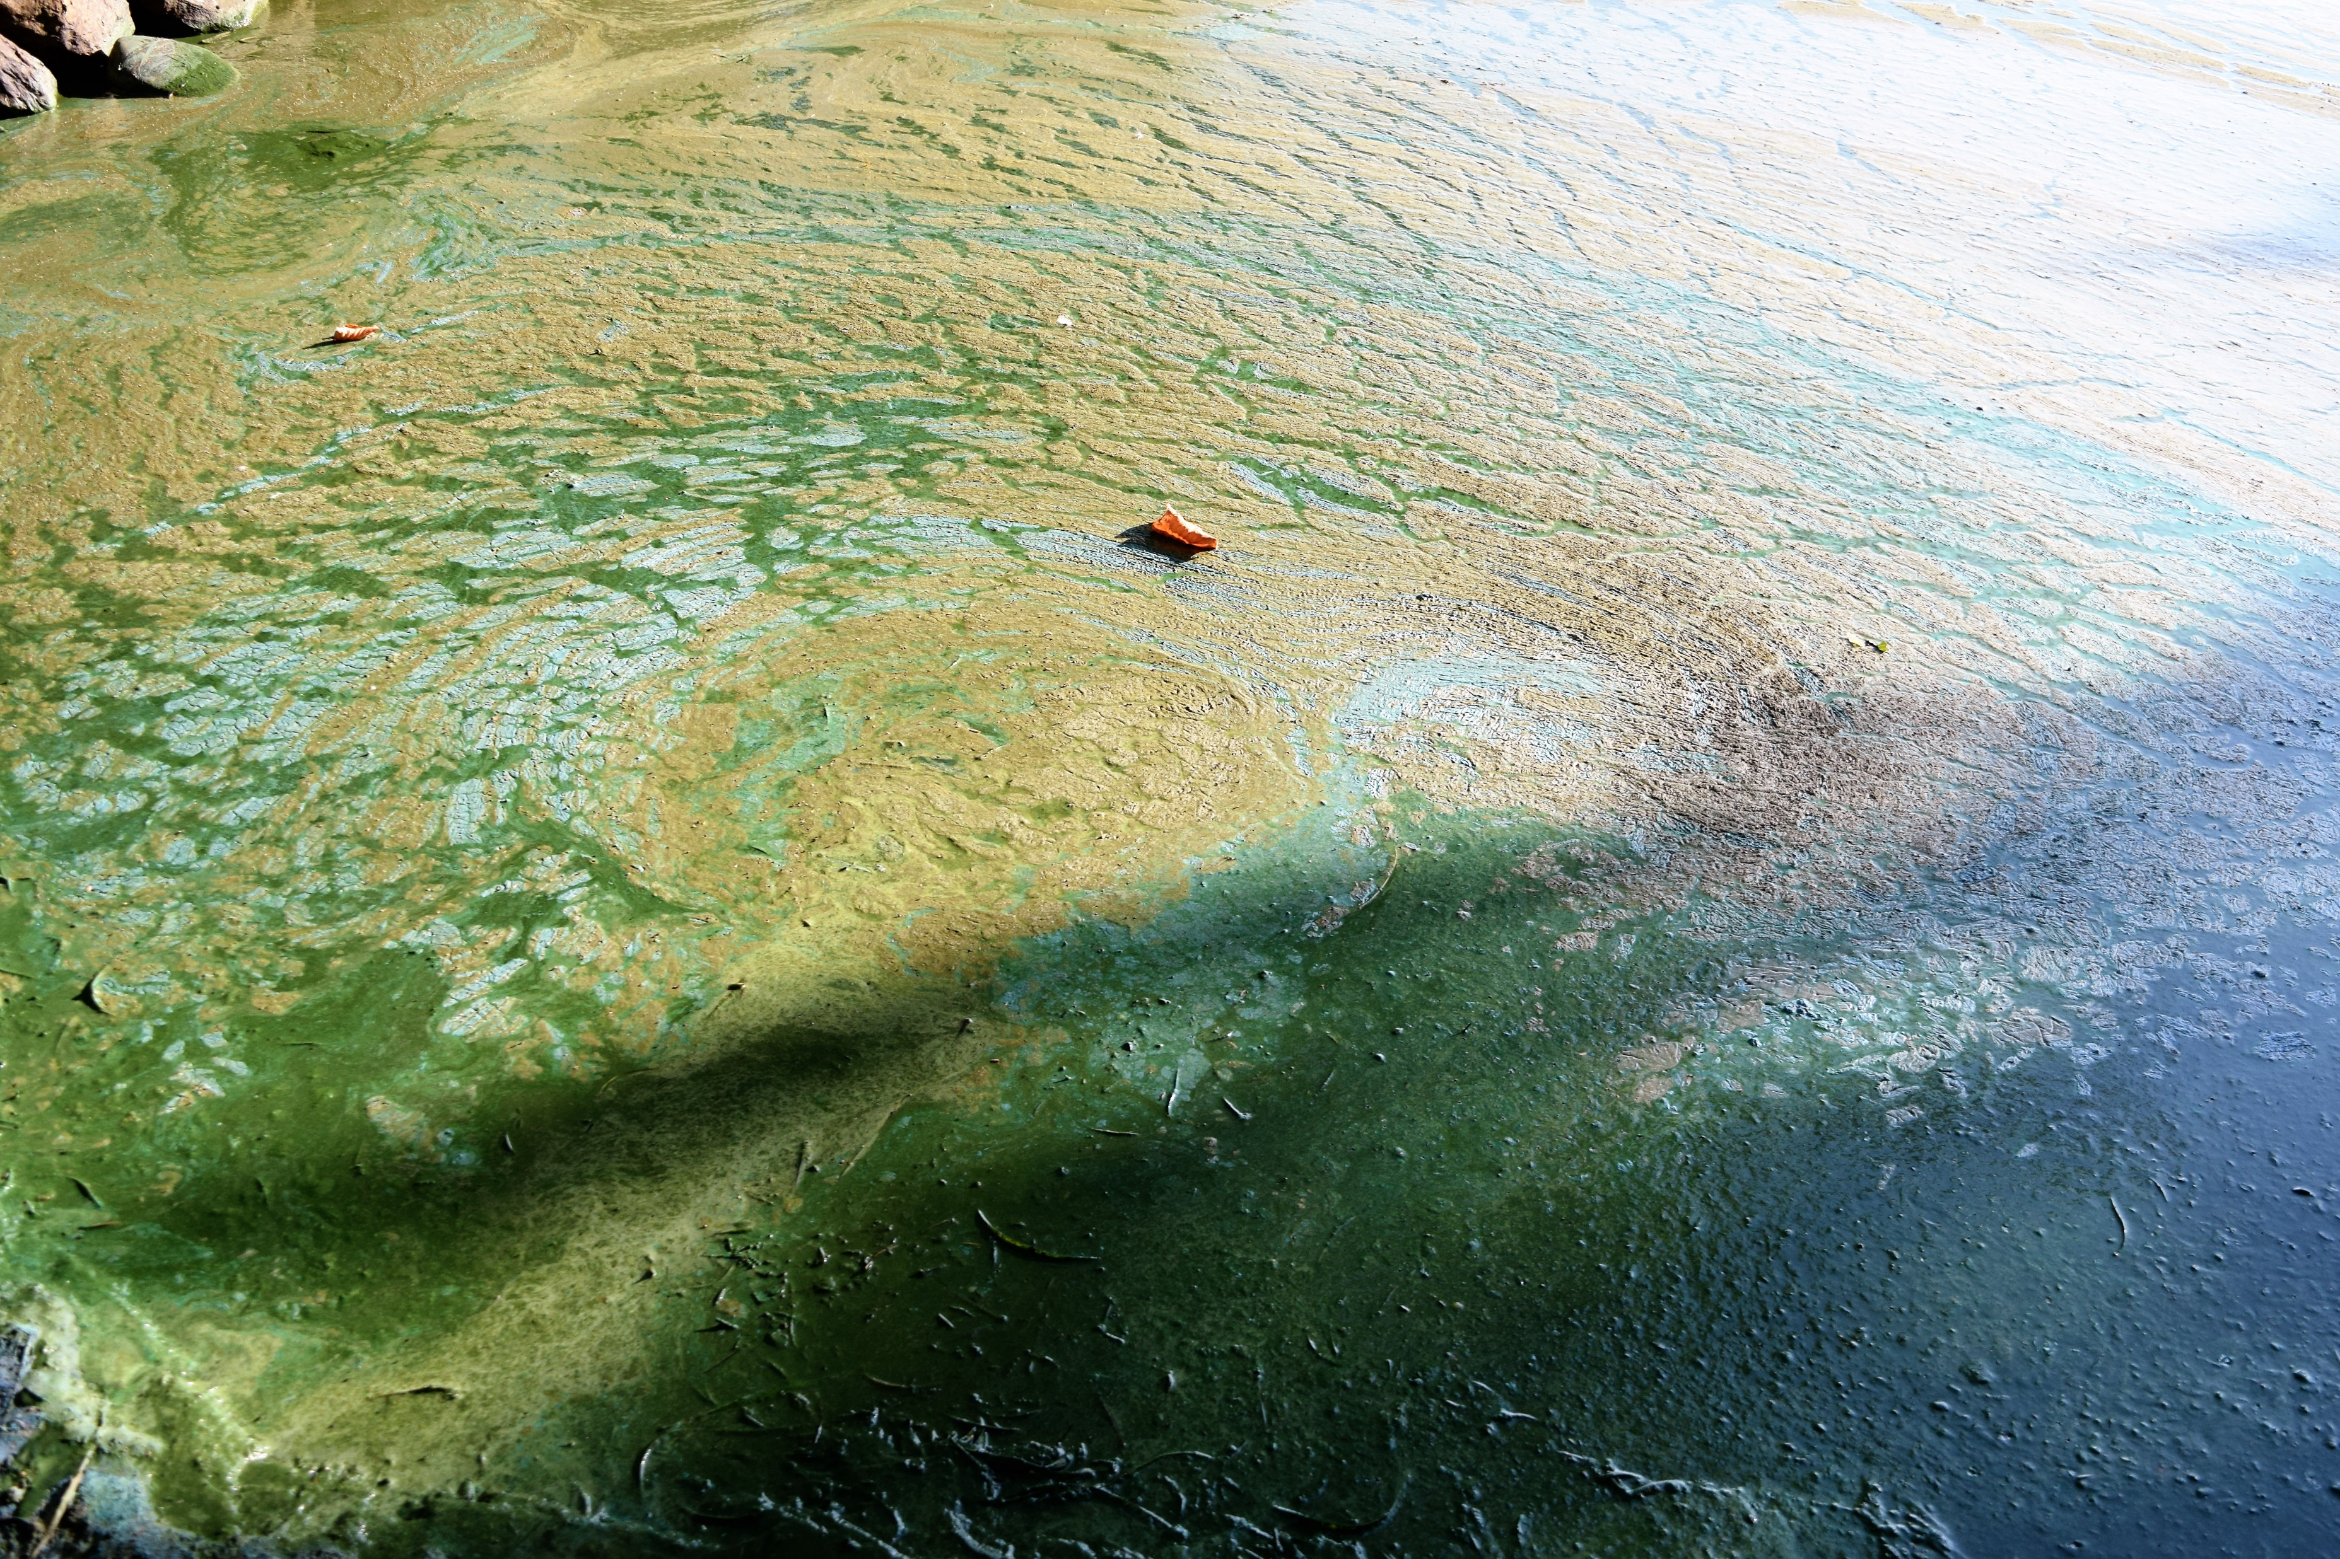
August 2017

Slide 2
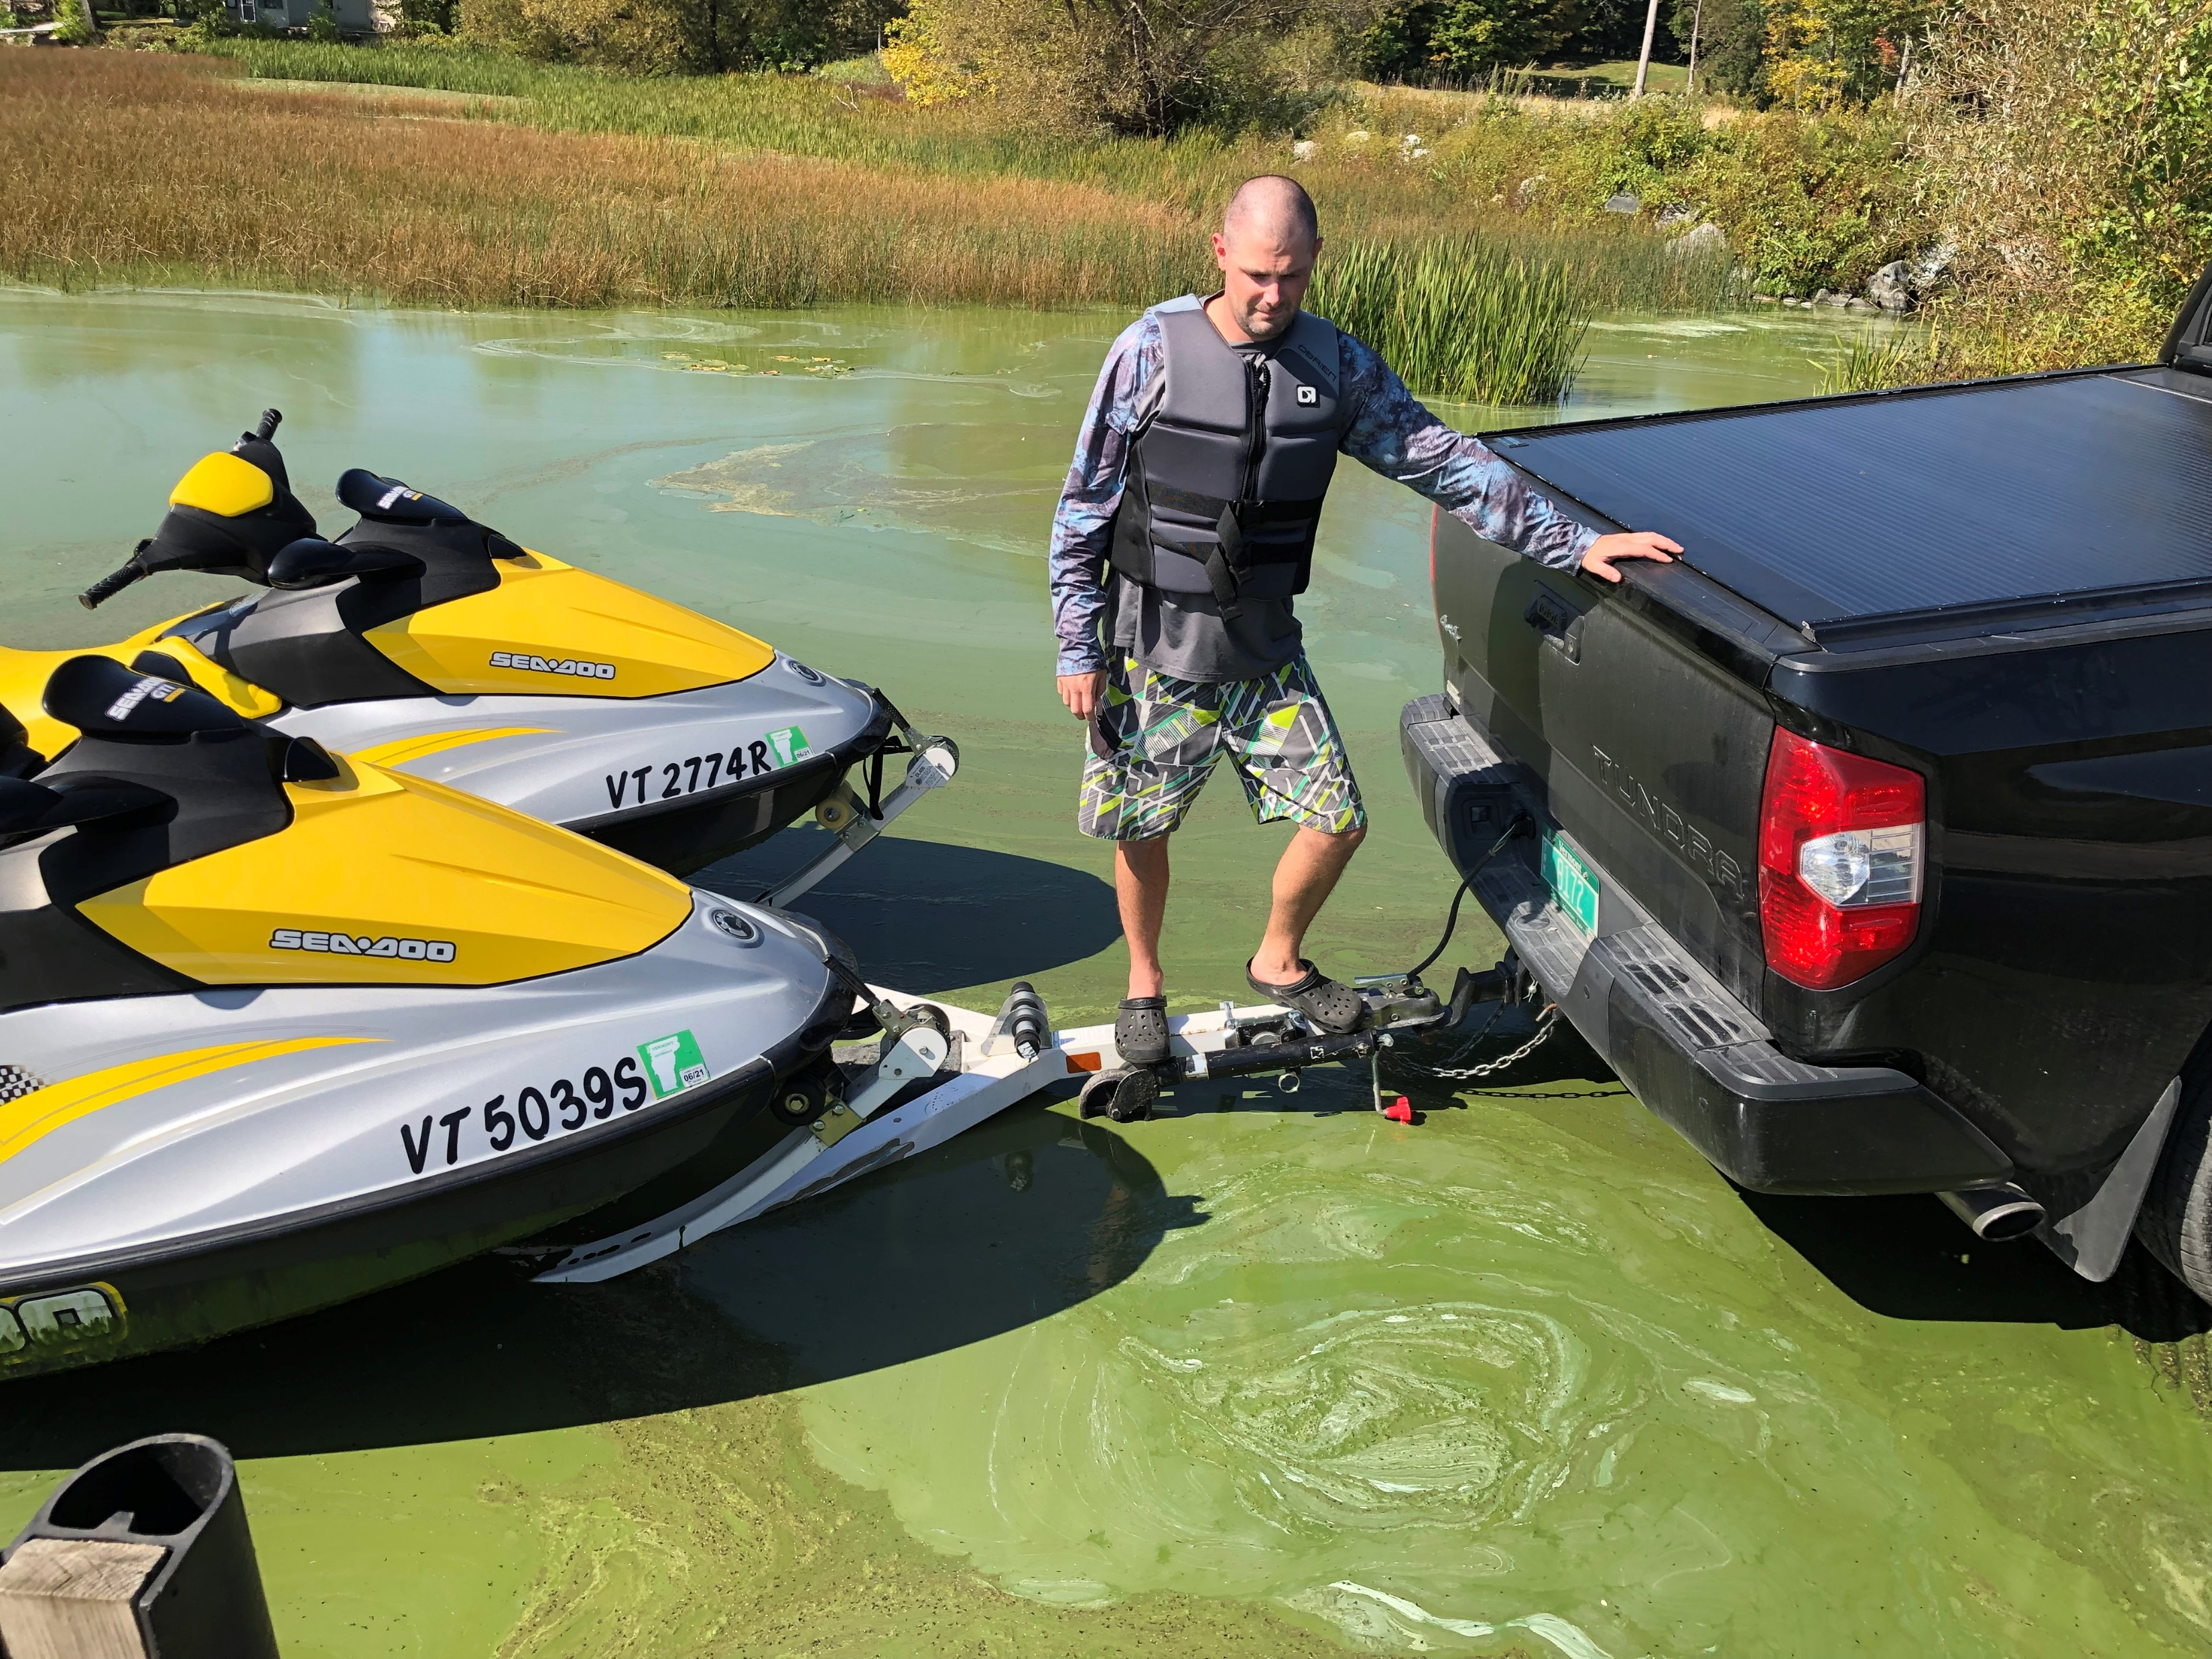
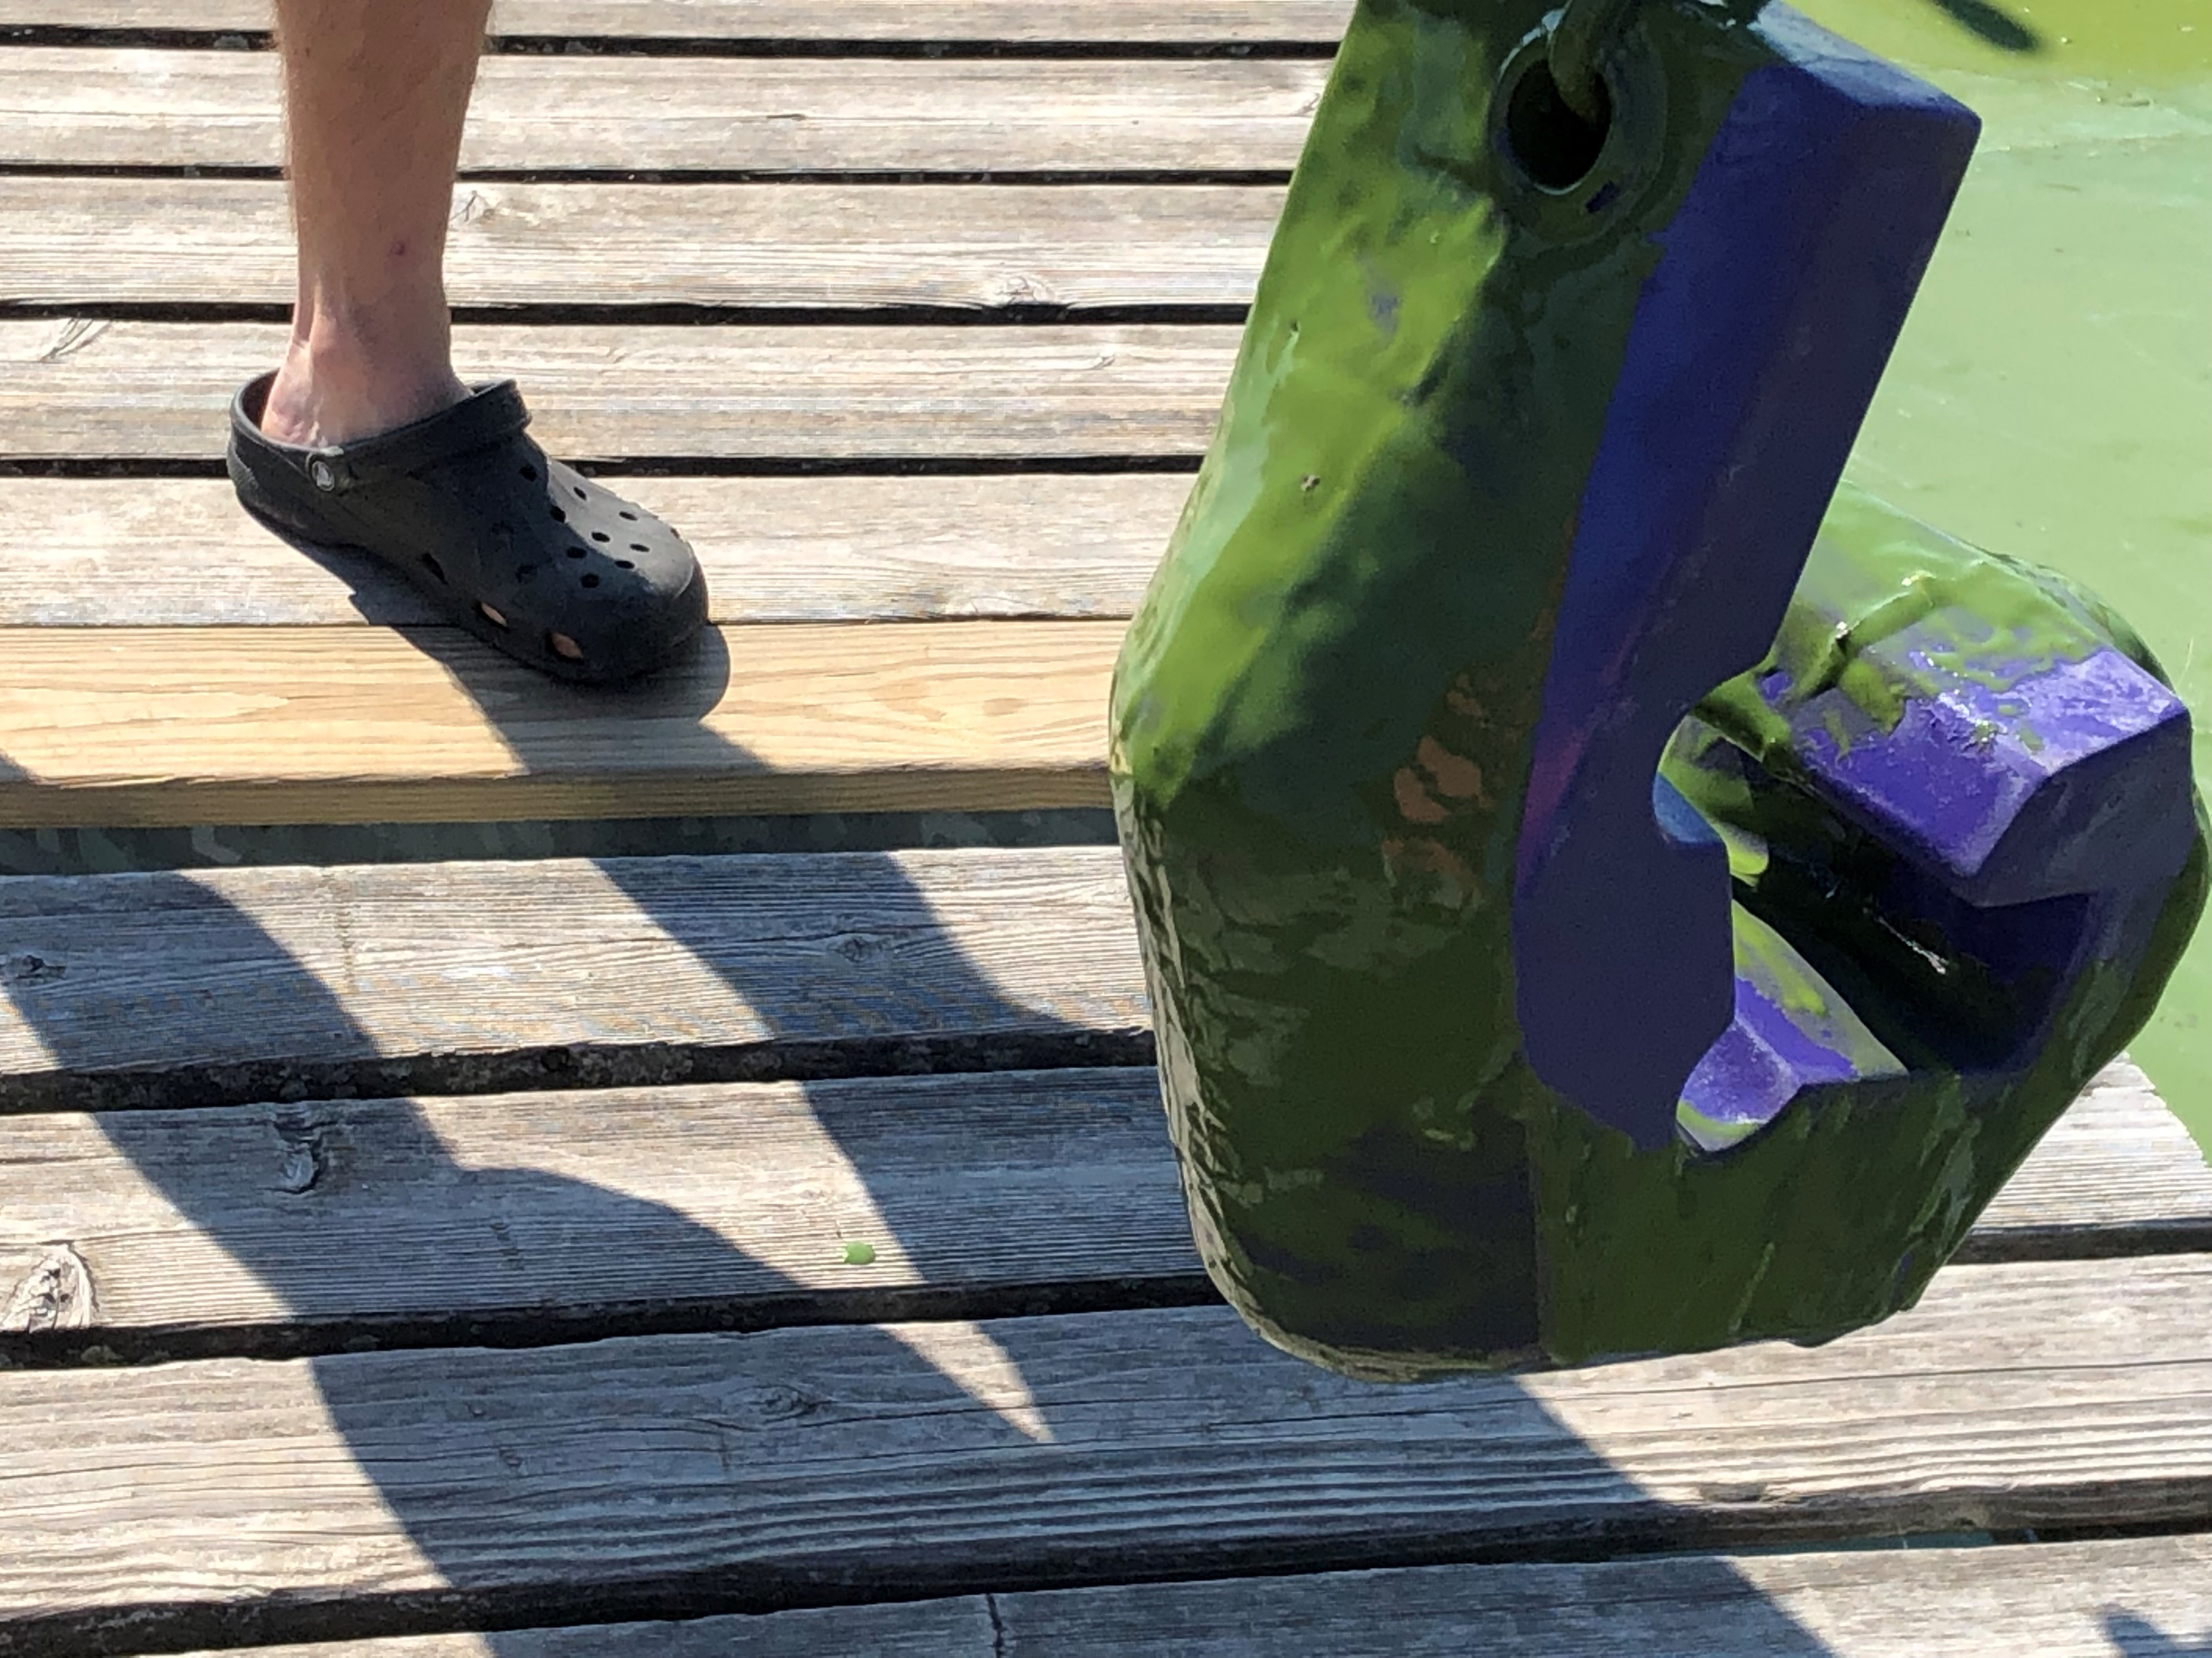
September 2019

Slide 3
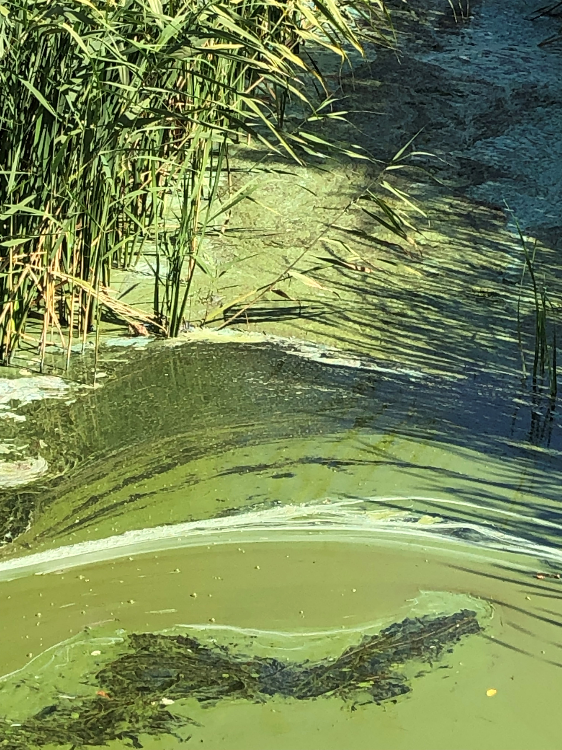
September 2019

Slide 4
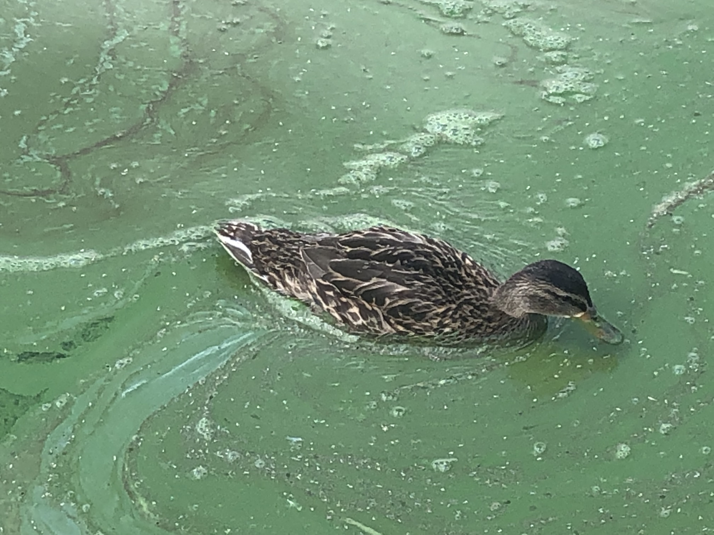
September 2019

Slide 5
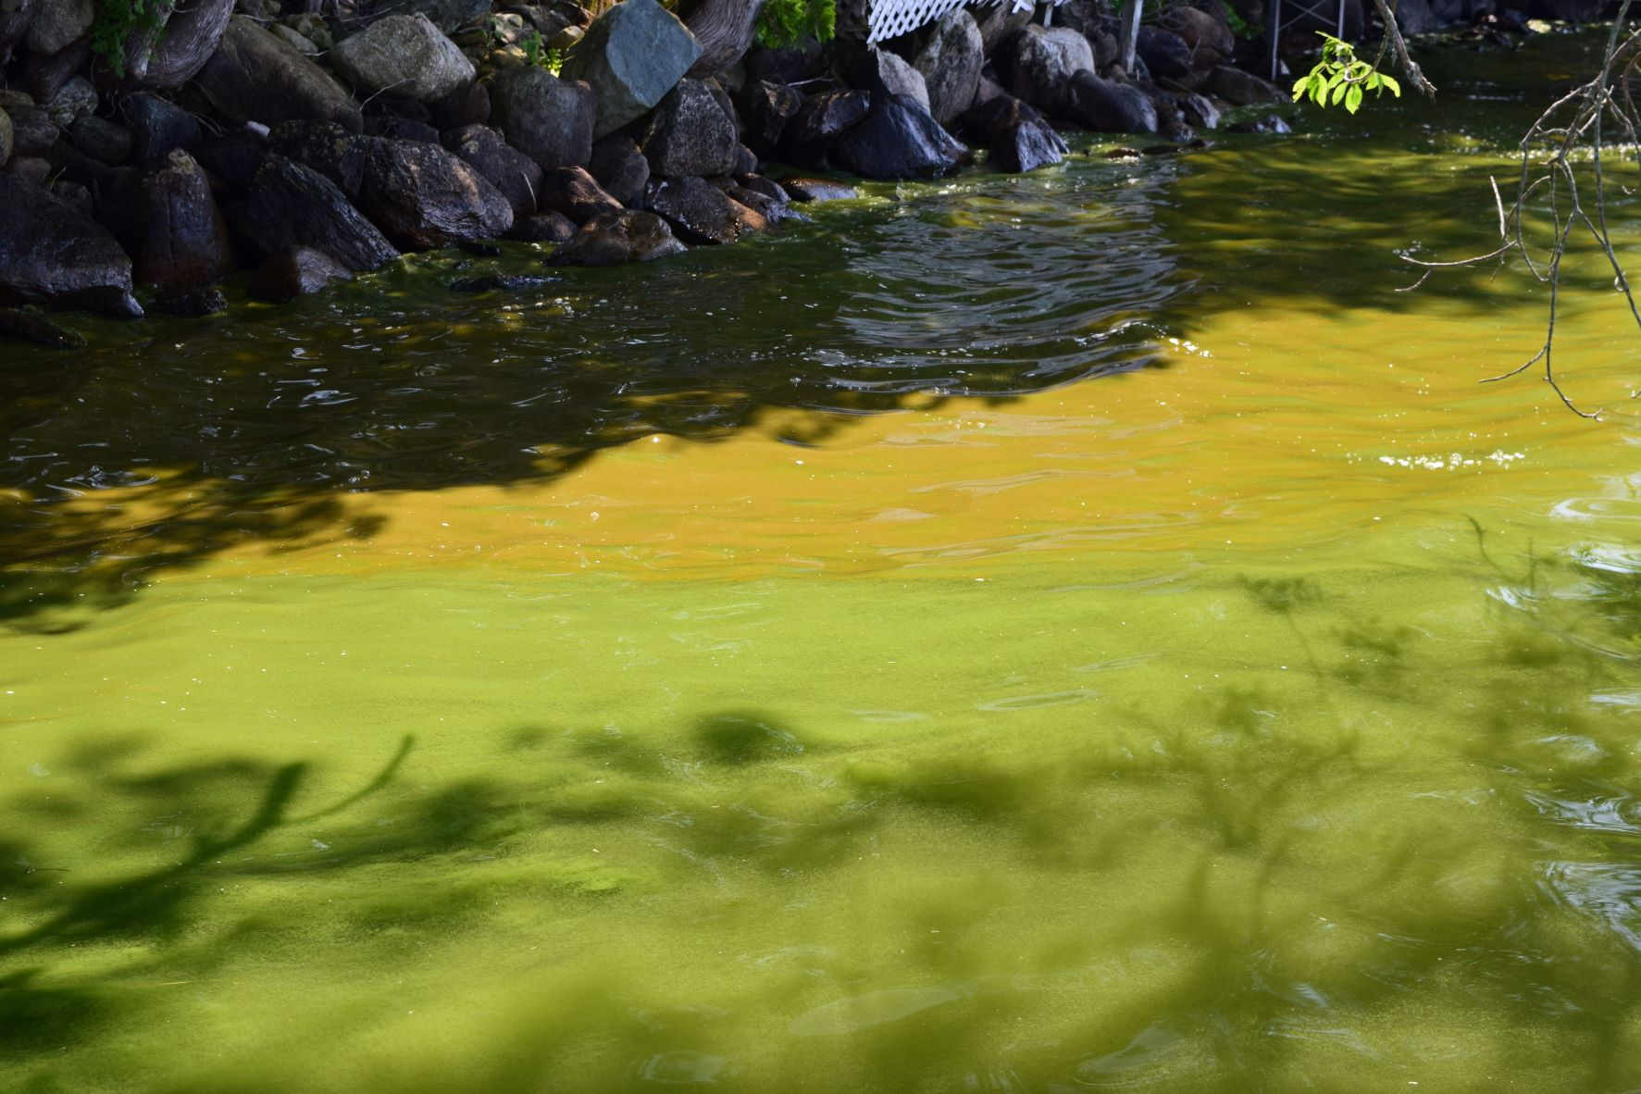
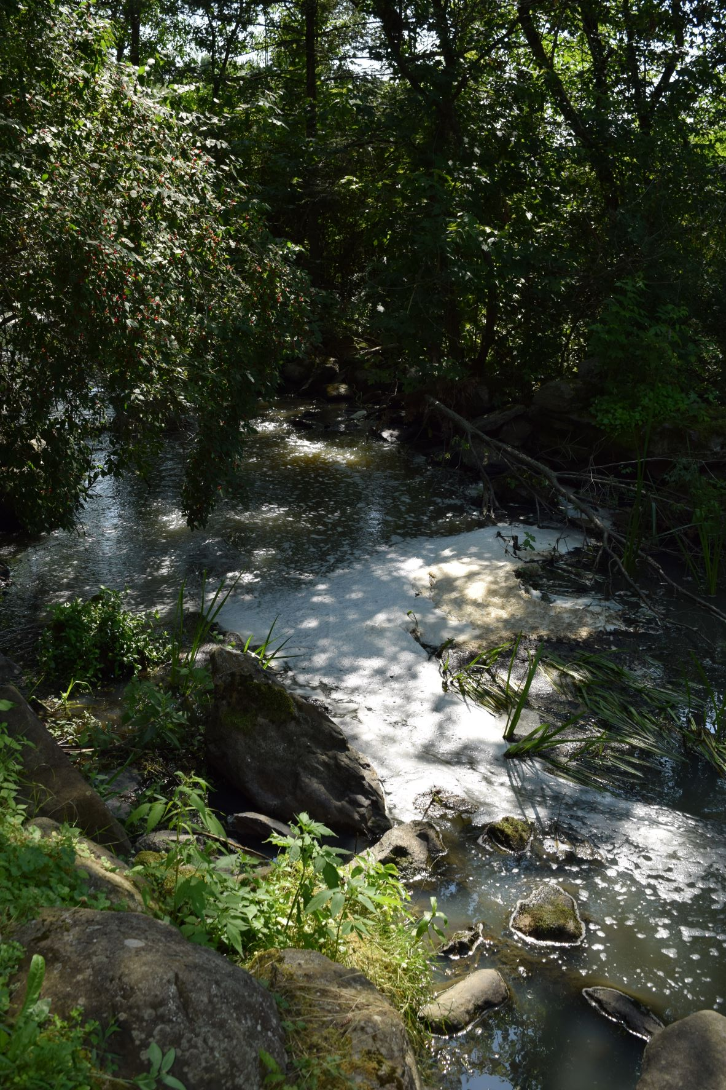
July 17, 2022
Cyanobacteria bloom heading to Lake Champlain via Pike River.
North Shoreline

Slide 6
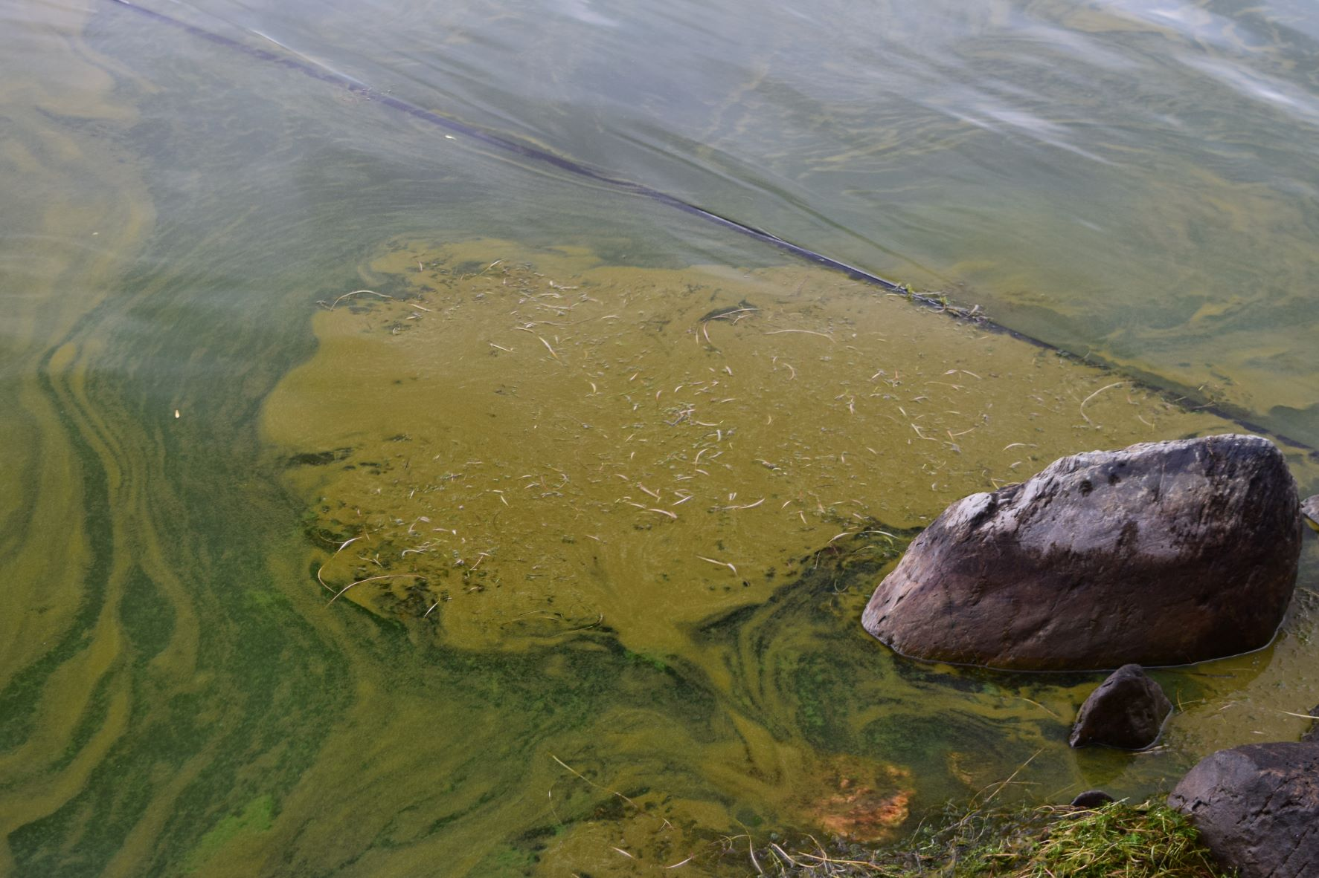
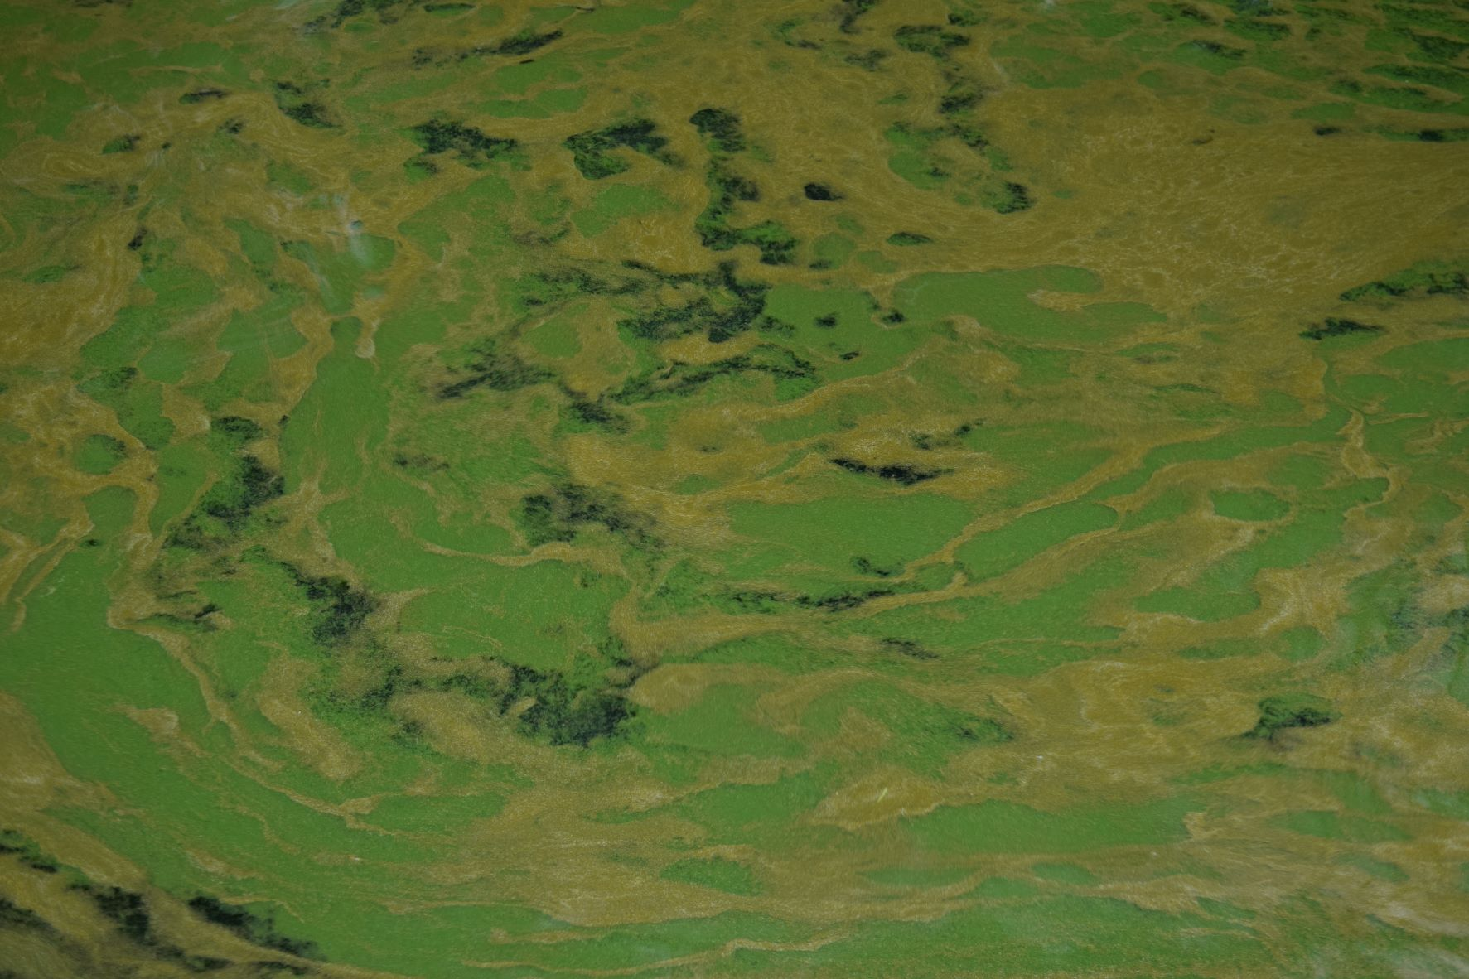
July 18, 2022

Slide 7
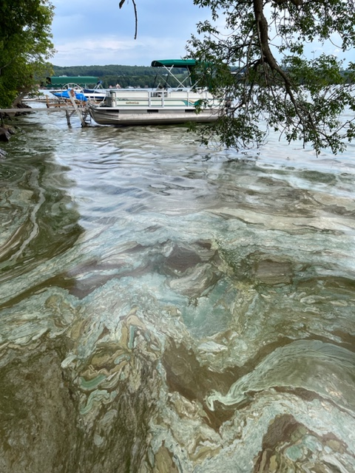
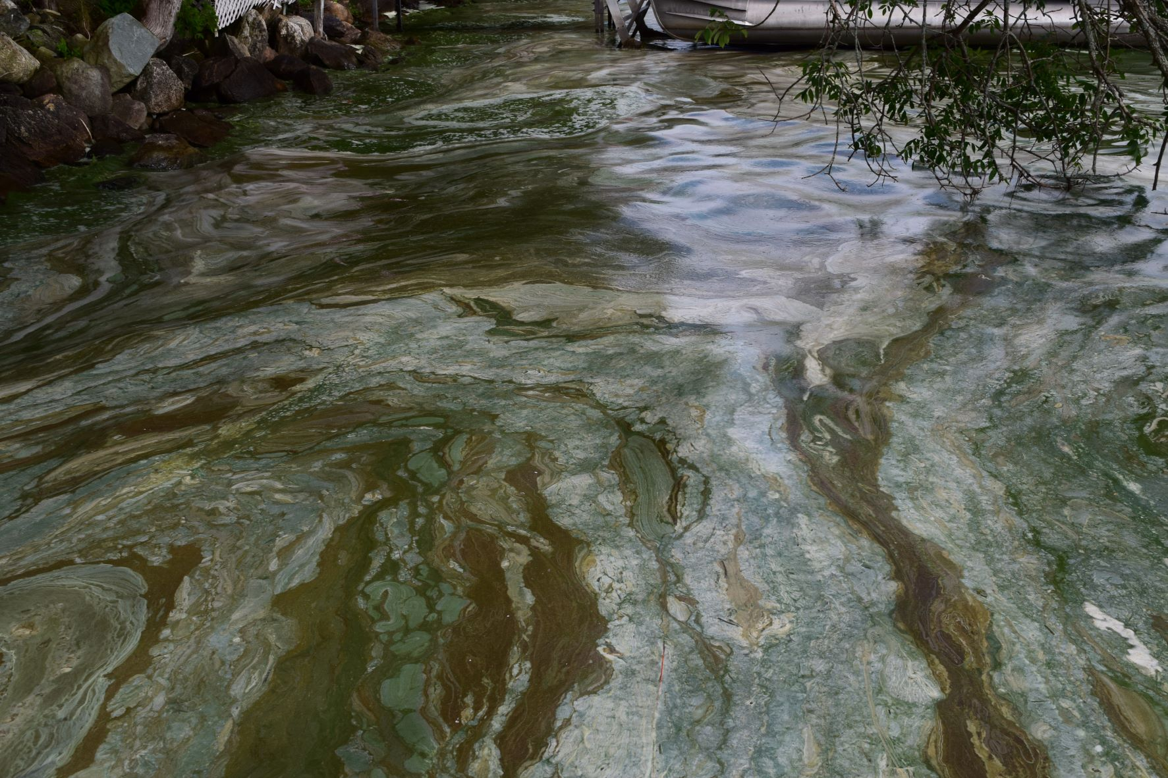
July 20, 2022
North Shoreline

Slide 8
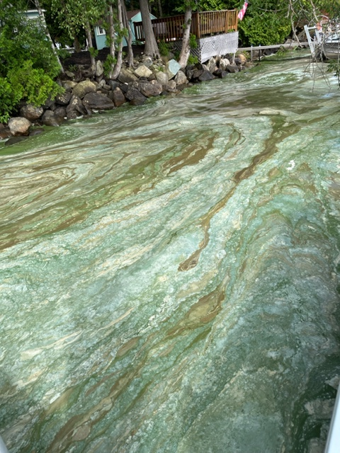
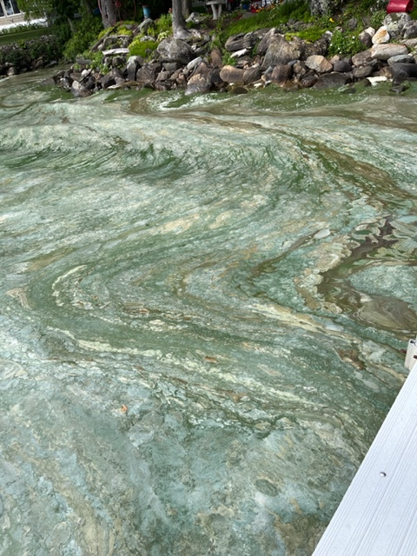
July 22, 2022
North Shoreline

Slide 9
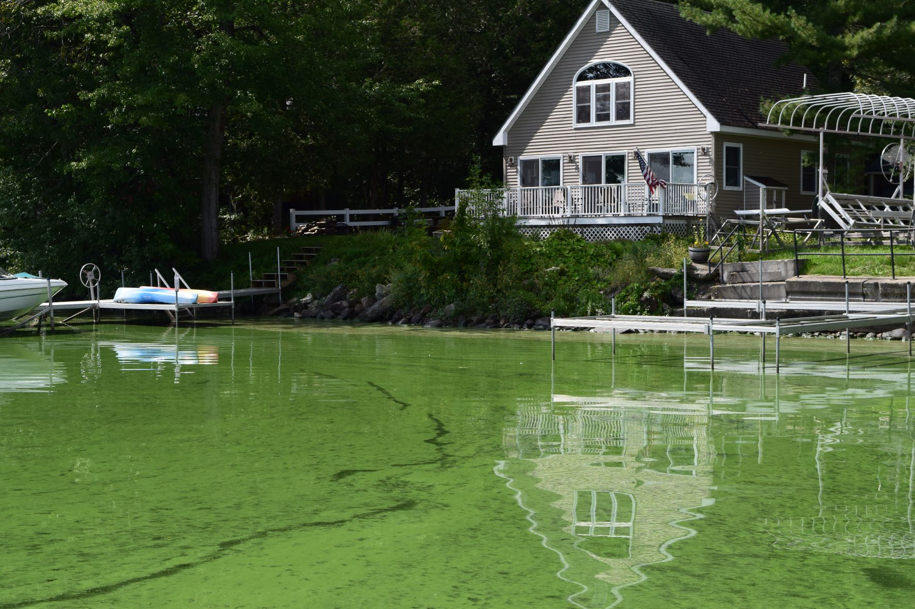
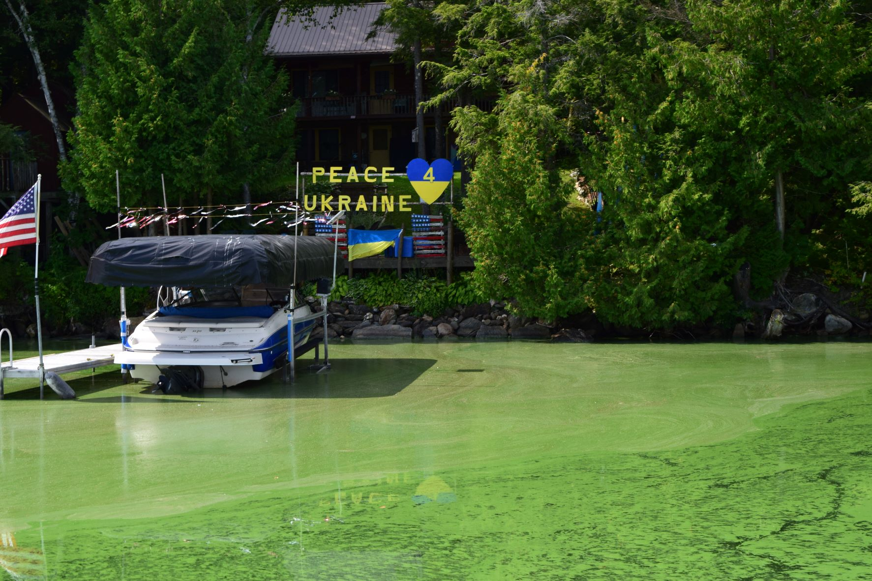
September 7, 2022
Patton Shore and Black Woods

Slide 10
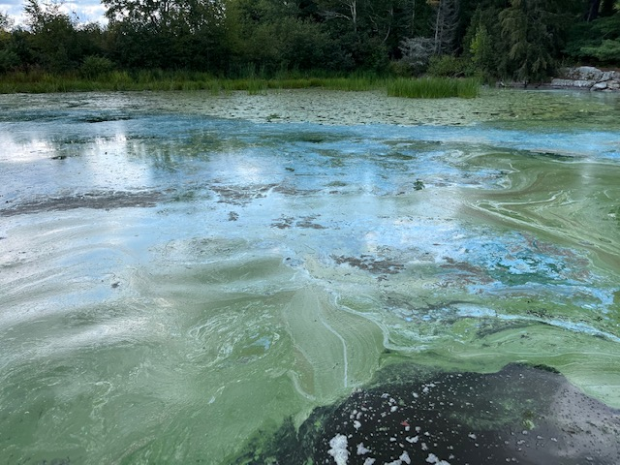
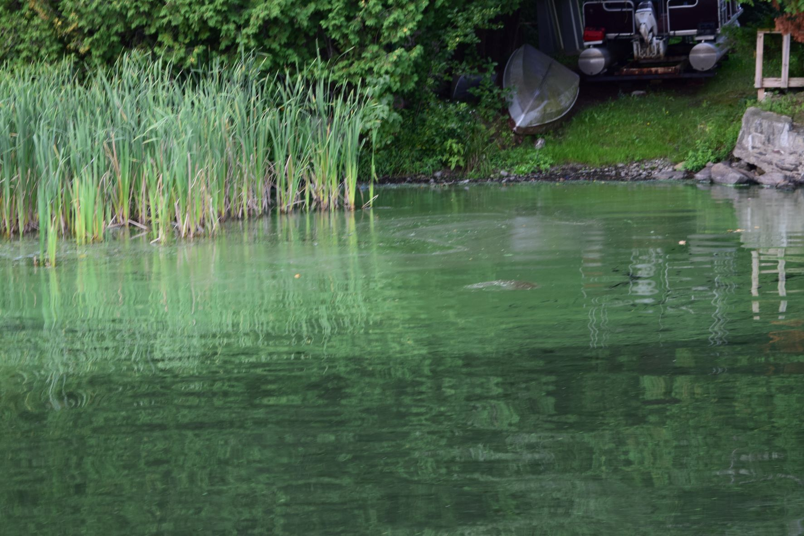
September 7, 2022
Wescott Shore to South End of Lake

Slide 11
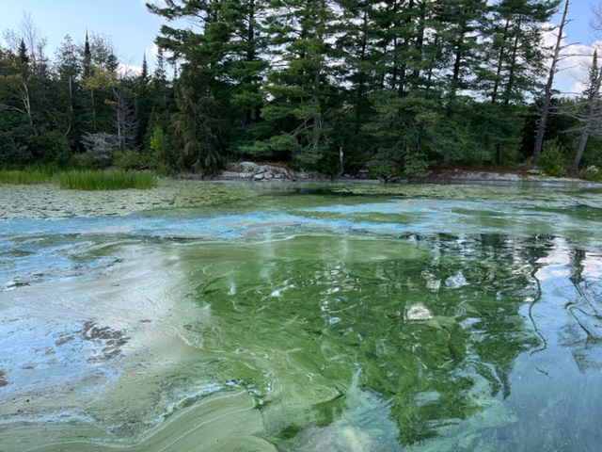
September 7, 2022
South End of Lake

Slide 12
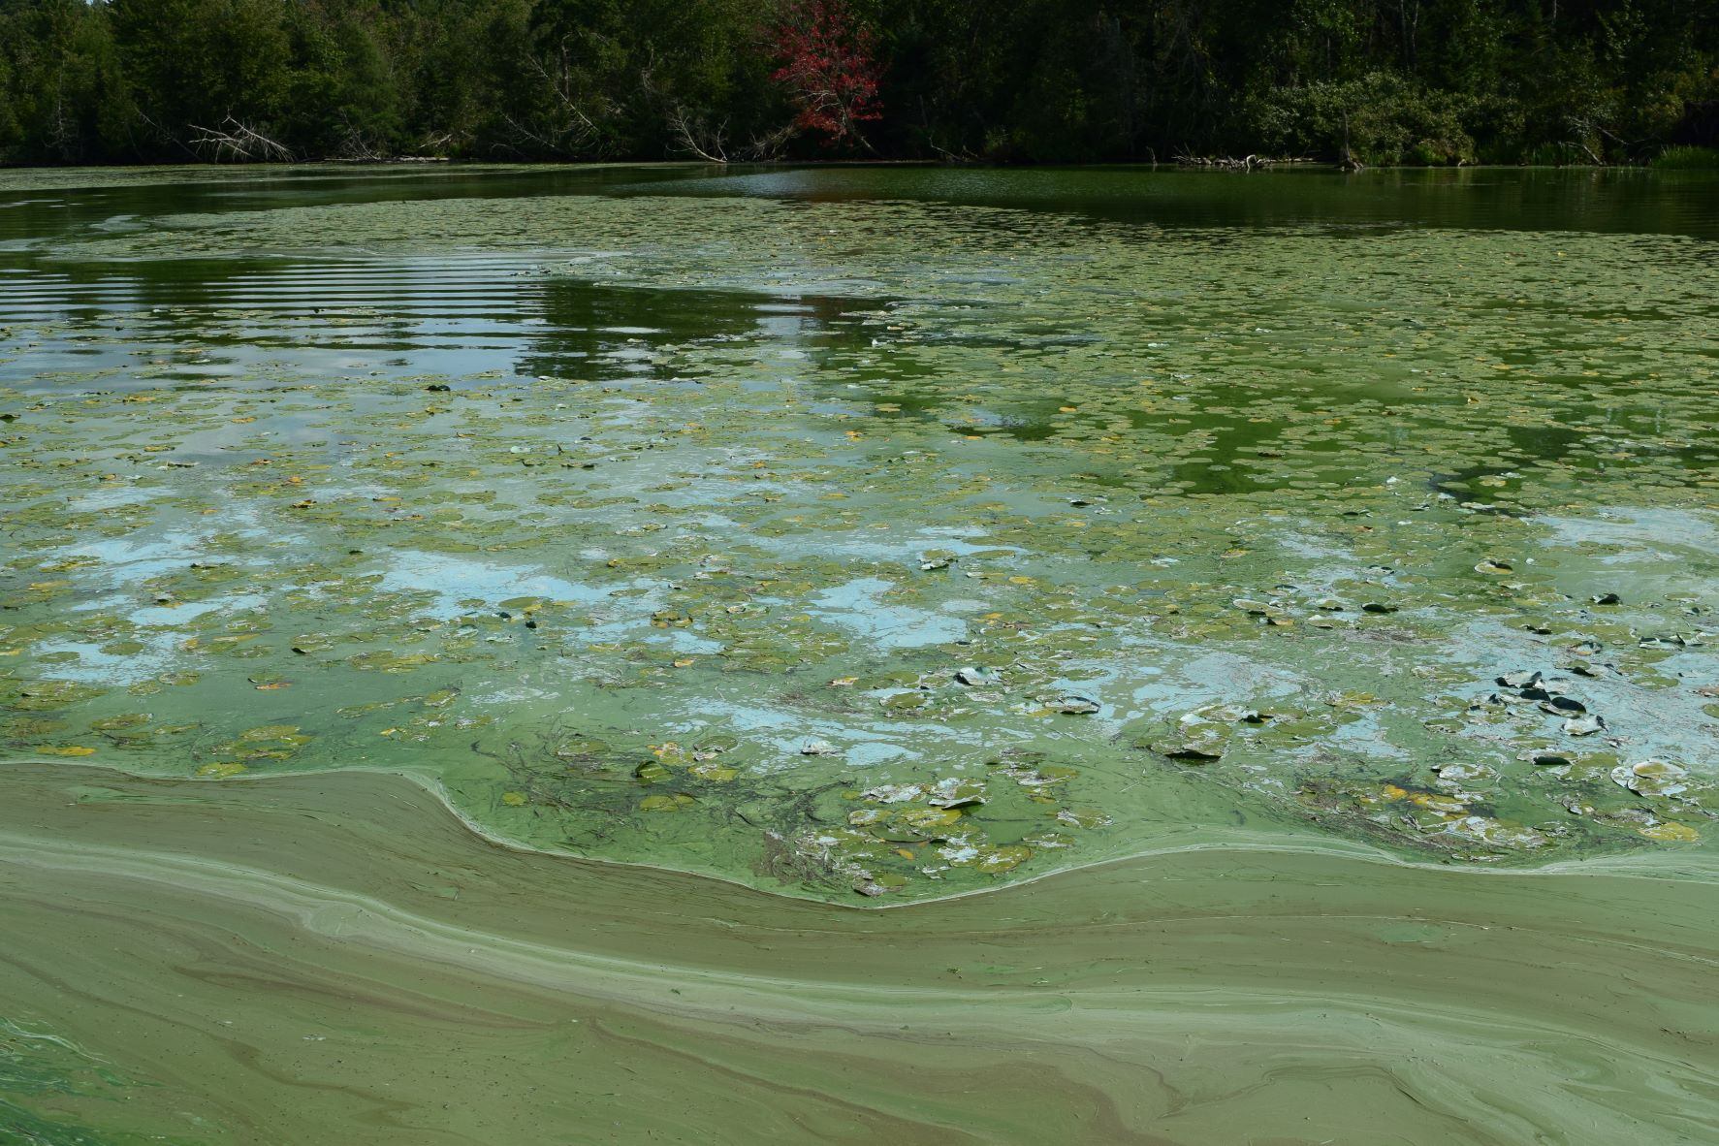
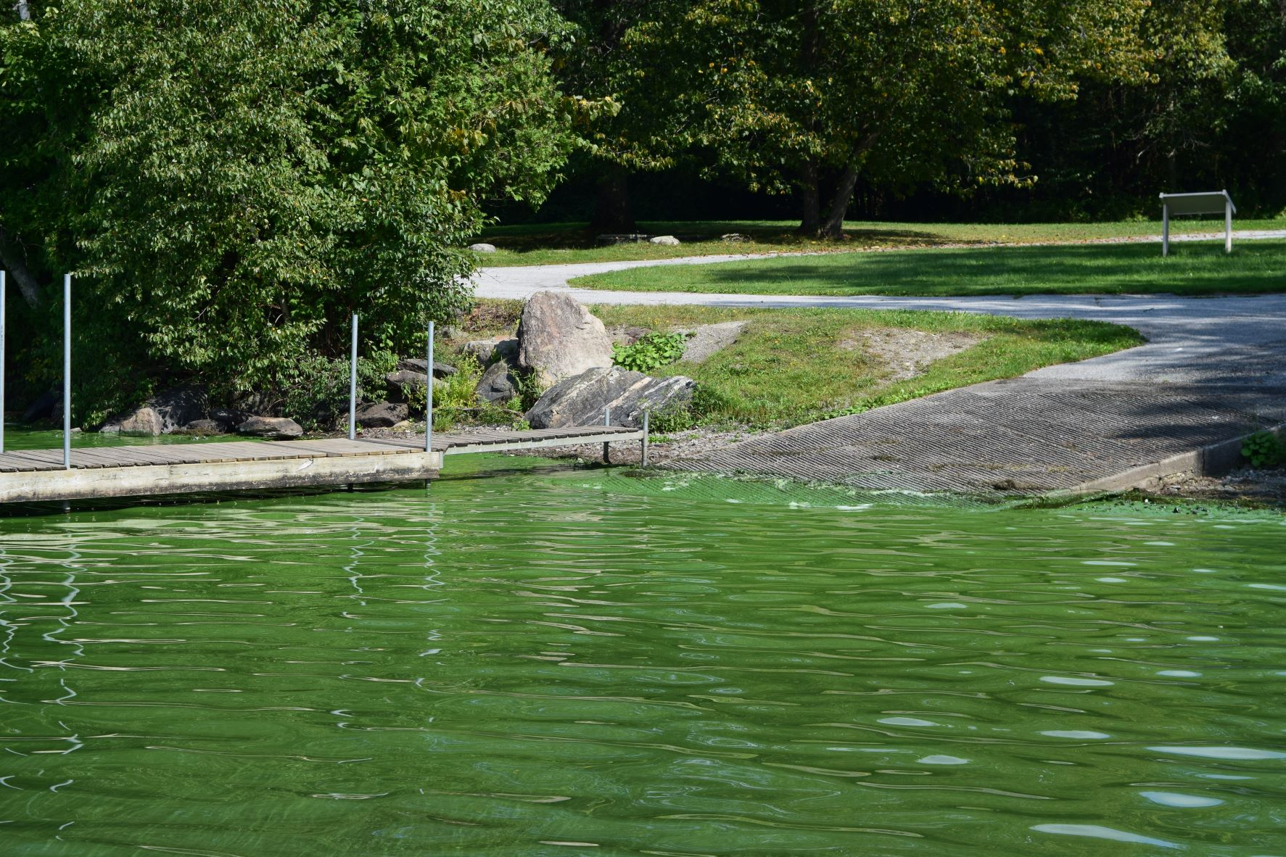
September 7, 2022
Lake Carmi State Park

Slide 13
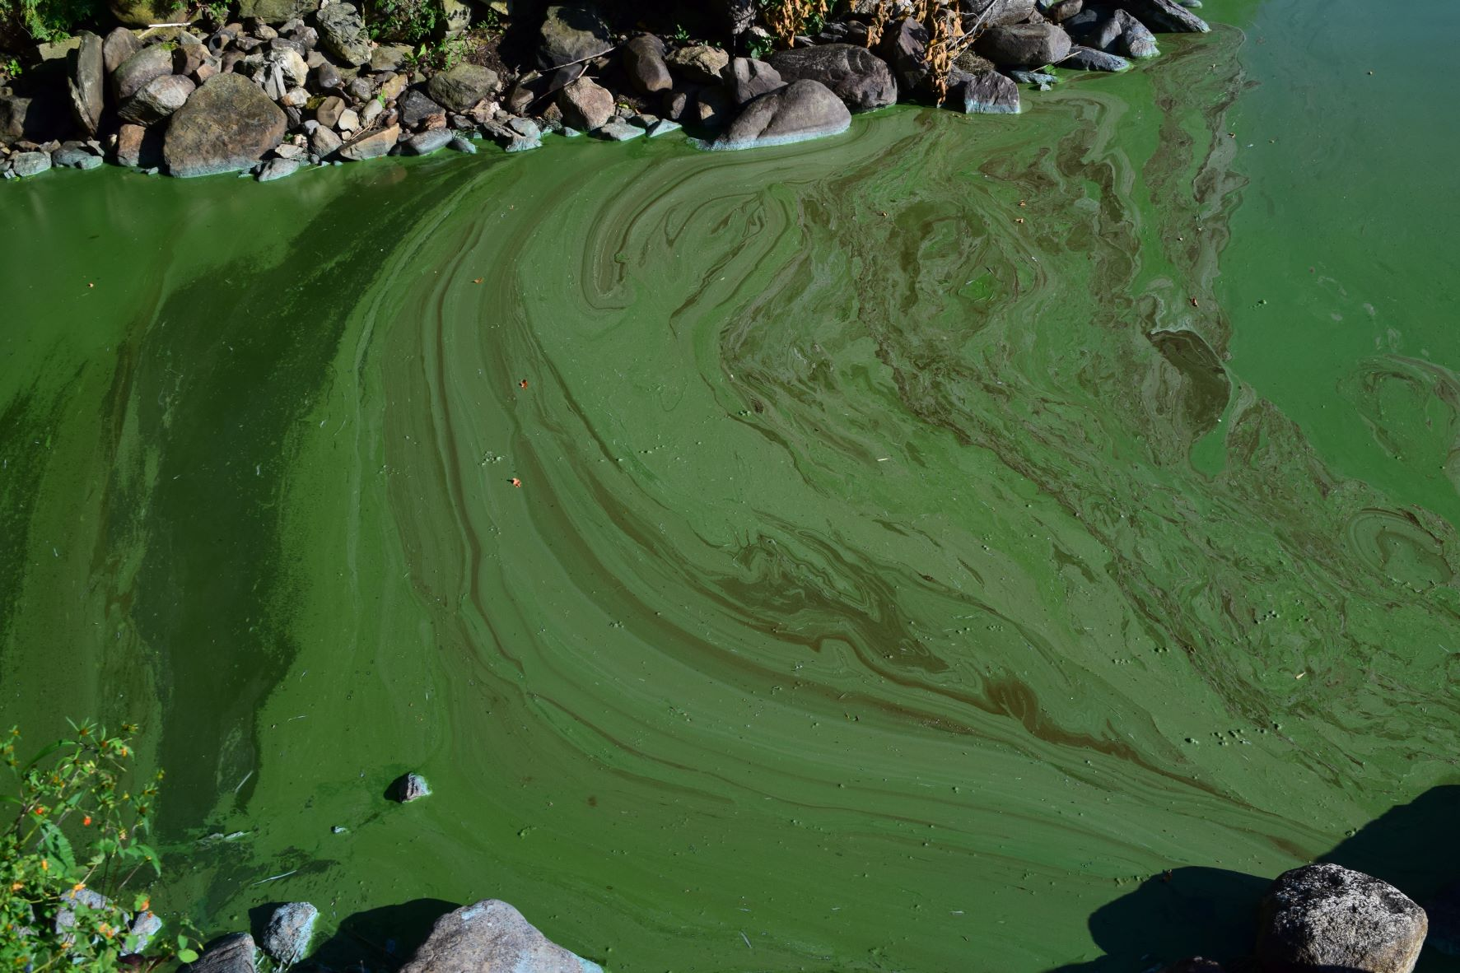
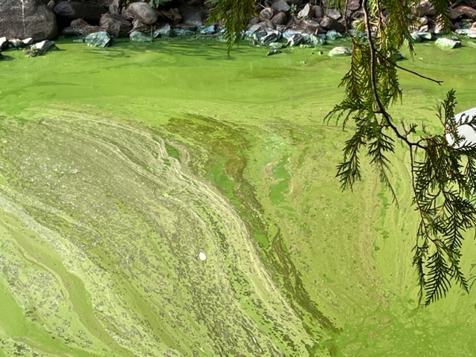
North Shoreline
September 8, 2022
September 9, 2022

Slide 14
WHY WE NEED TO SAVE LAKE CARMI

Slide 15
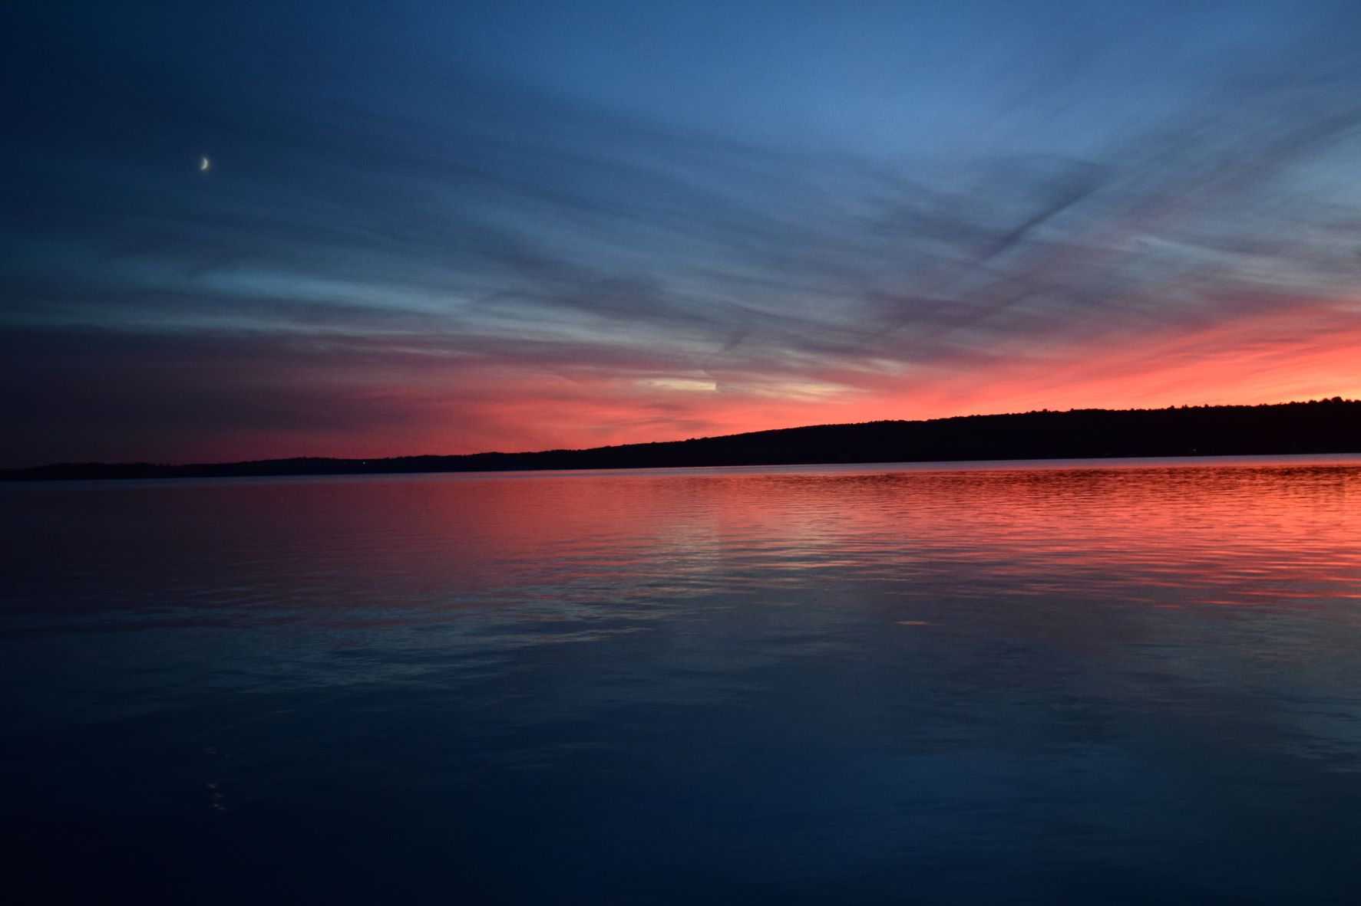
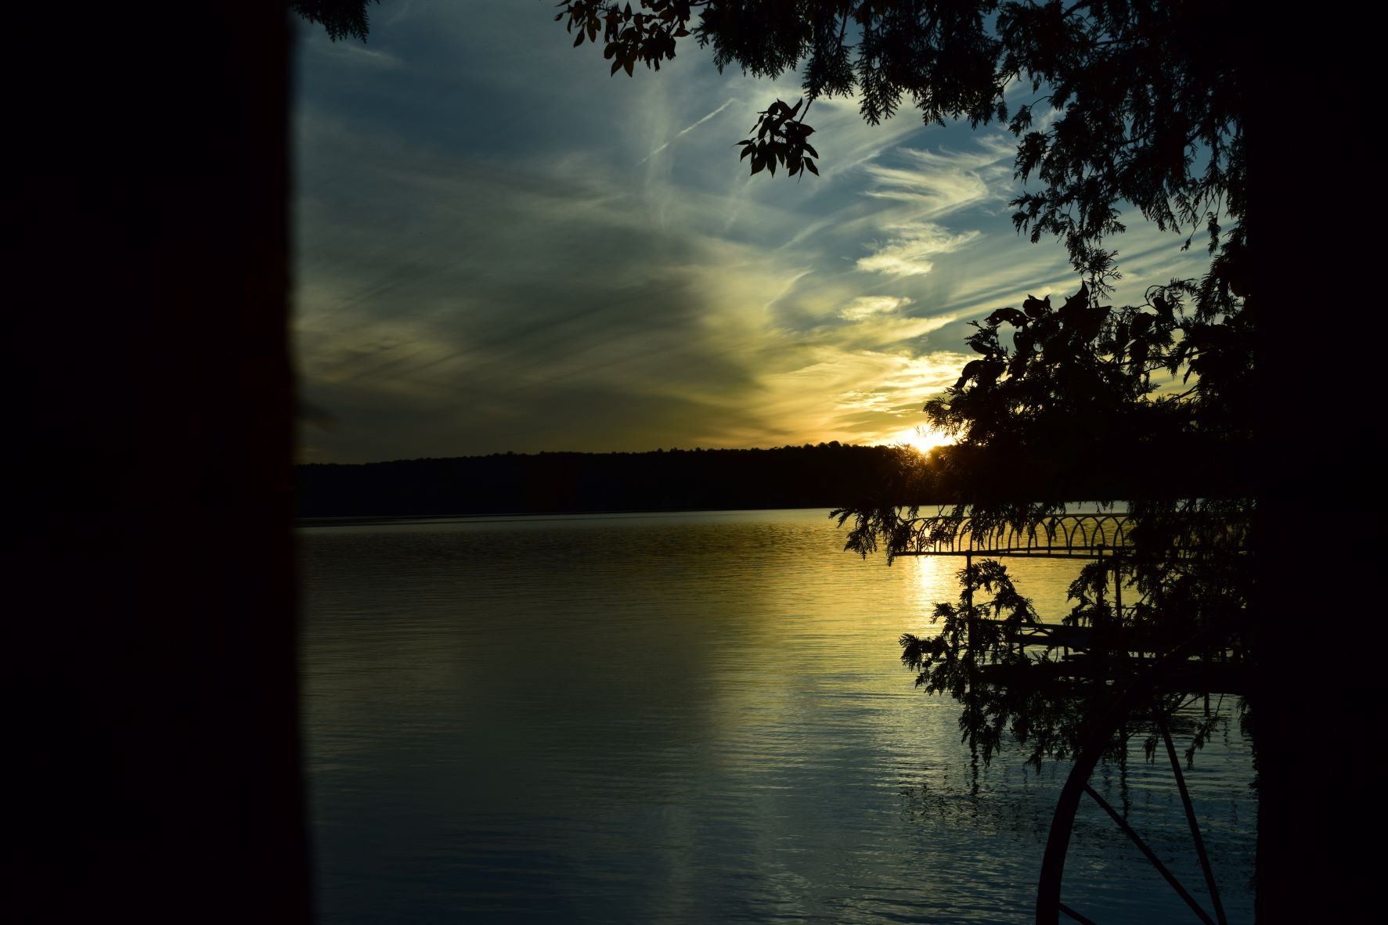
Sunsets

Slide 16
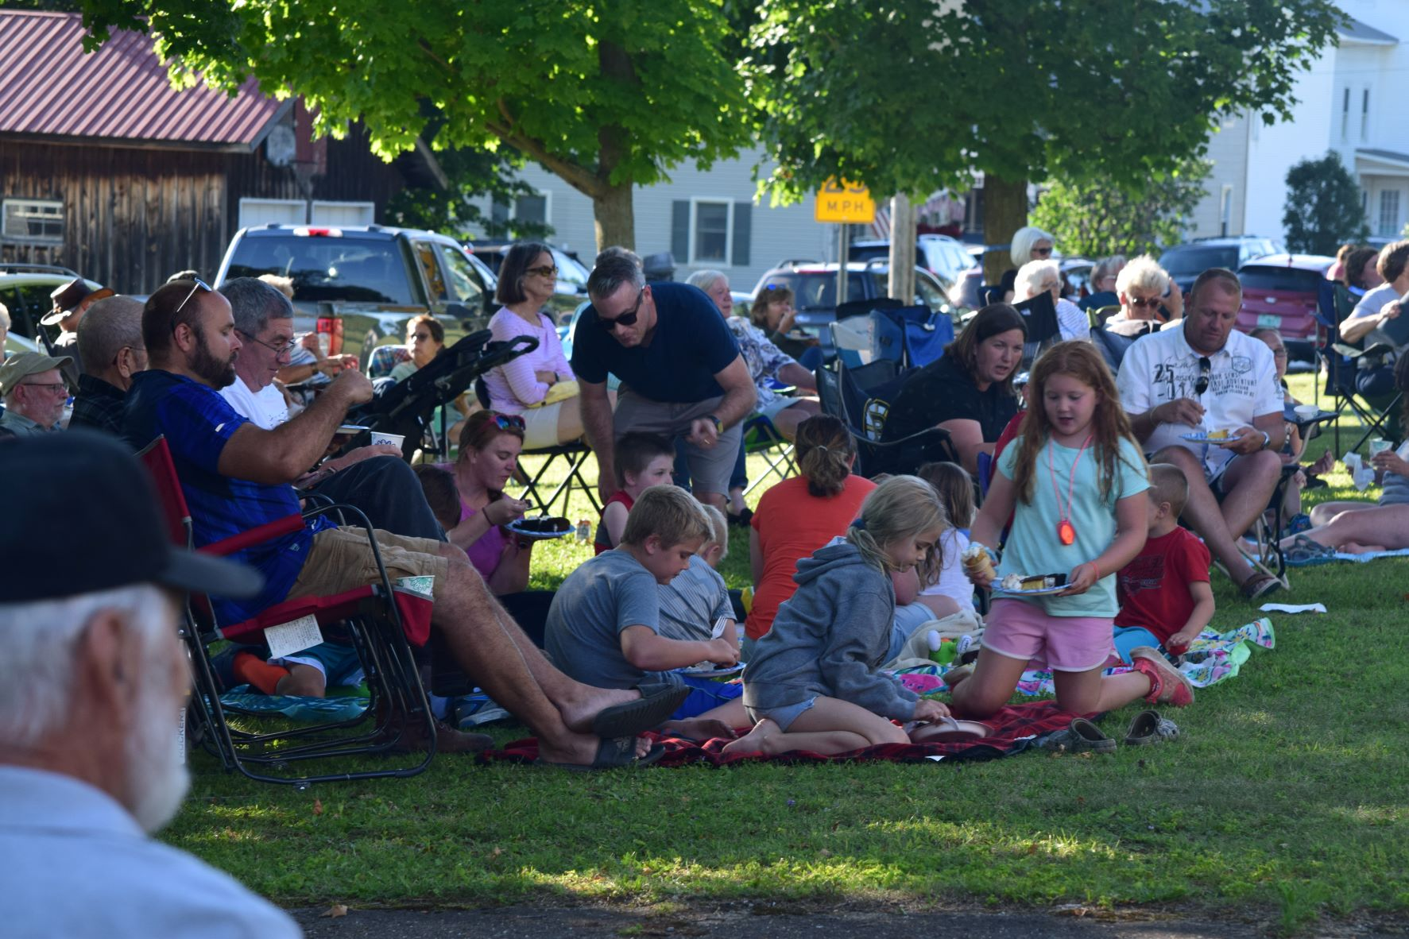
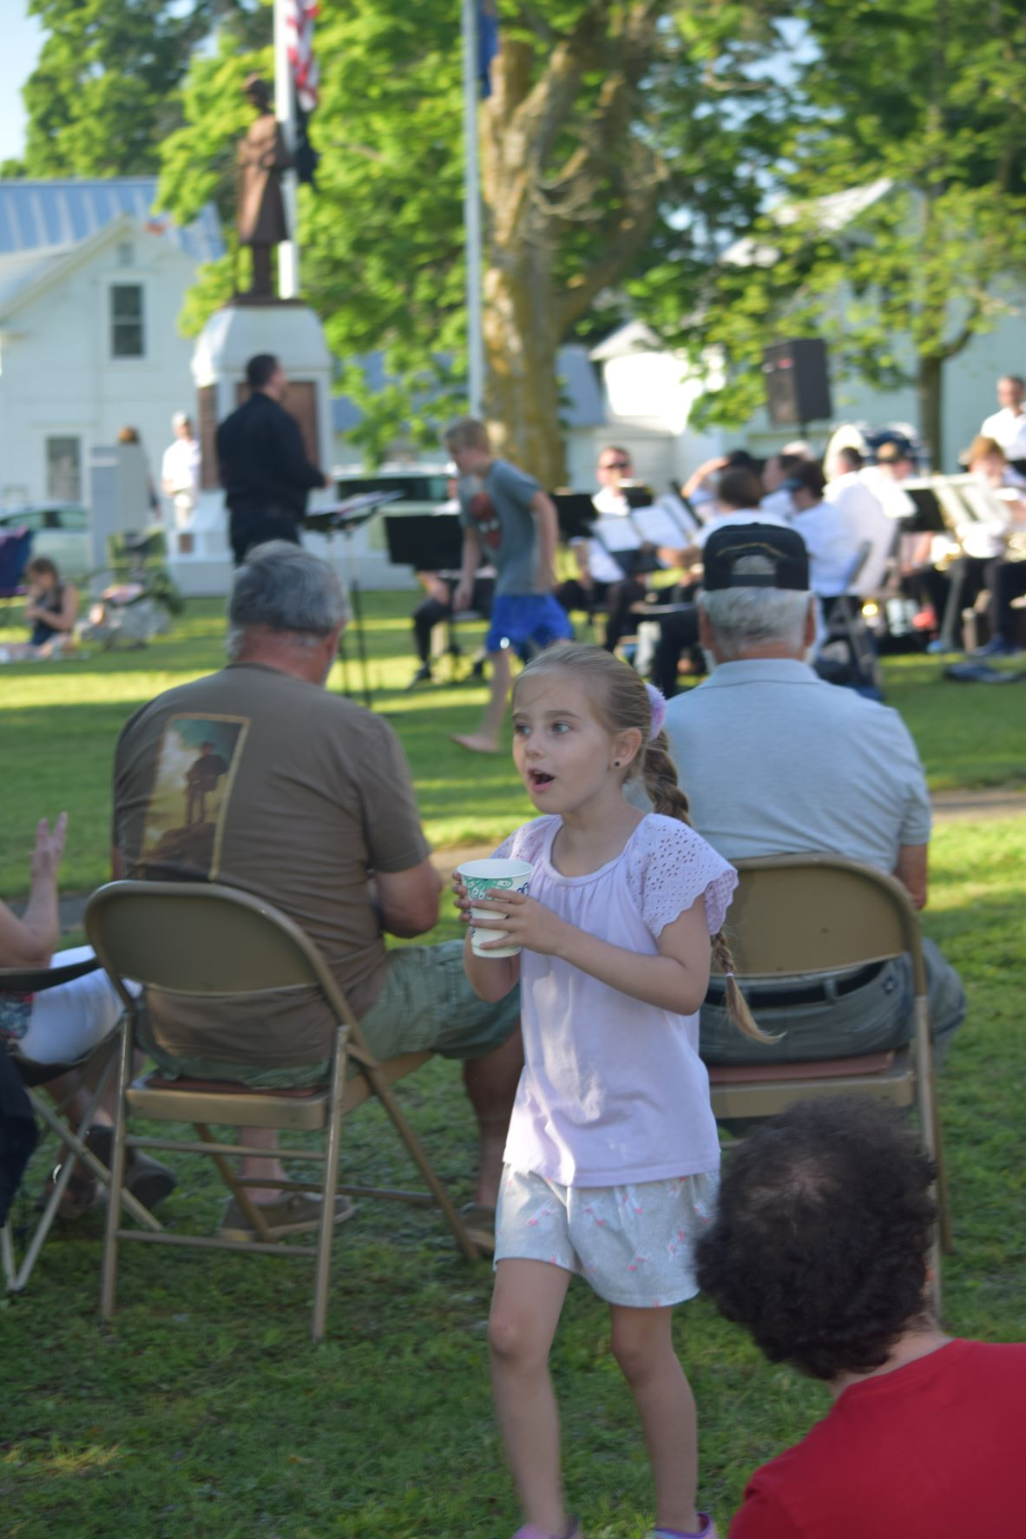
July 17, 2022
Concert on the Green-Sponsored by LCCA

Slide 17
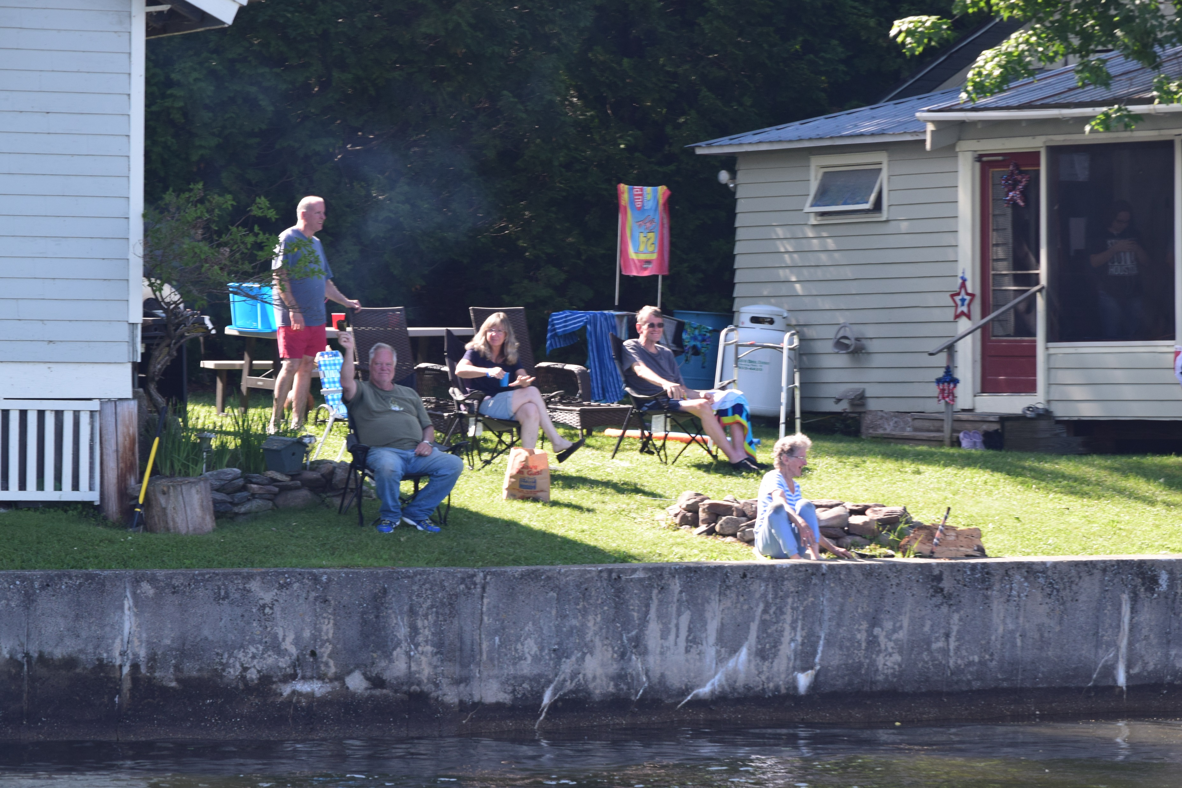
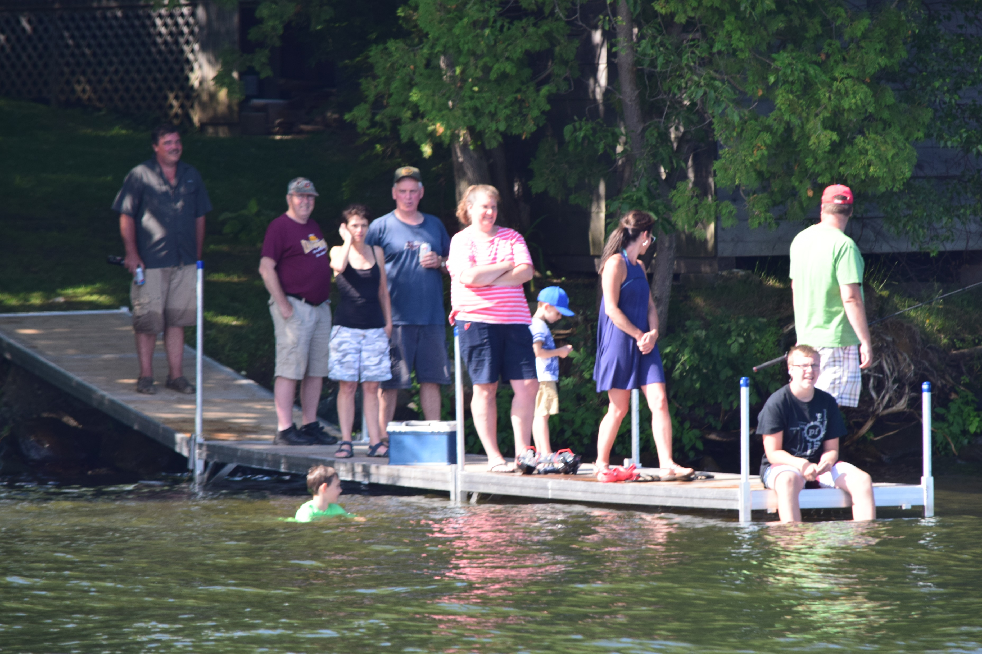
Families on the Lake.

Slide 18
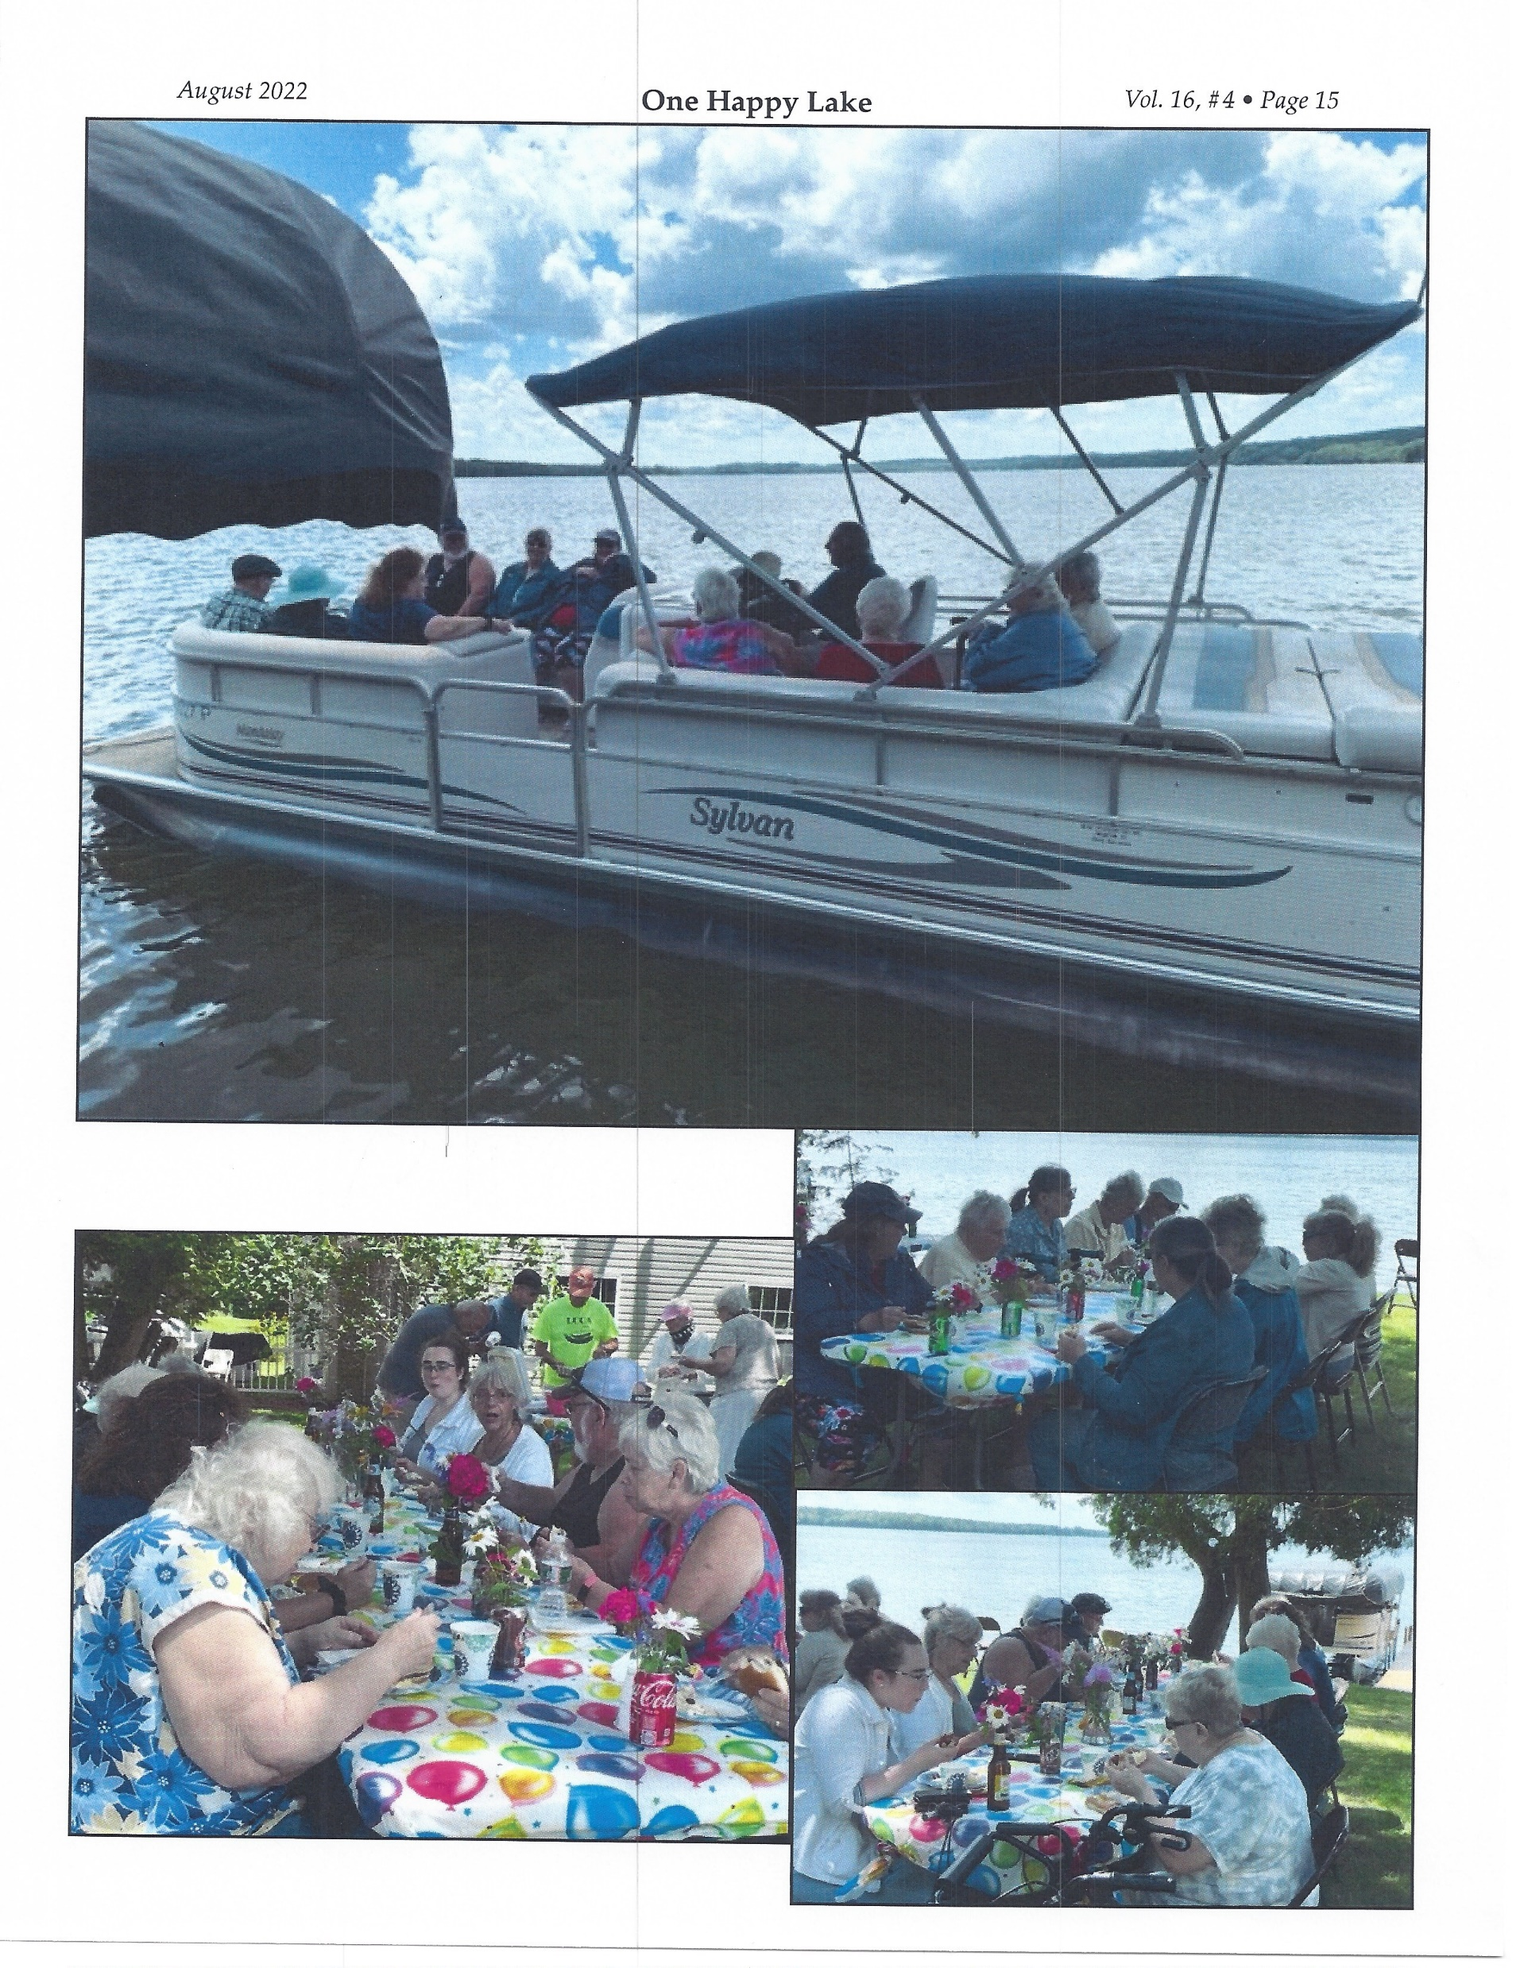
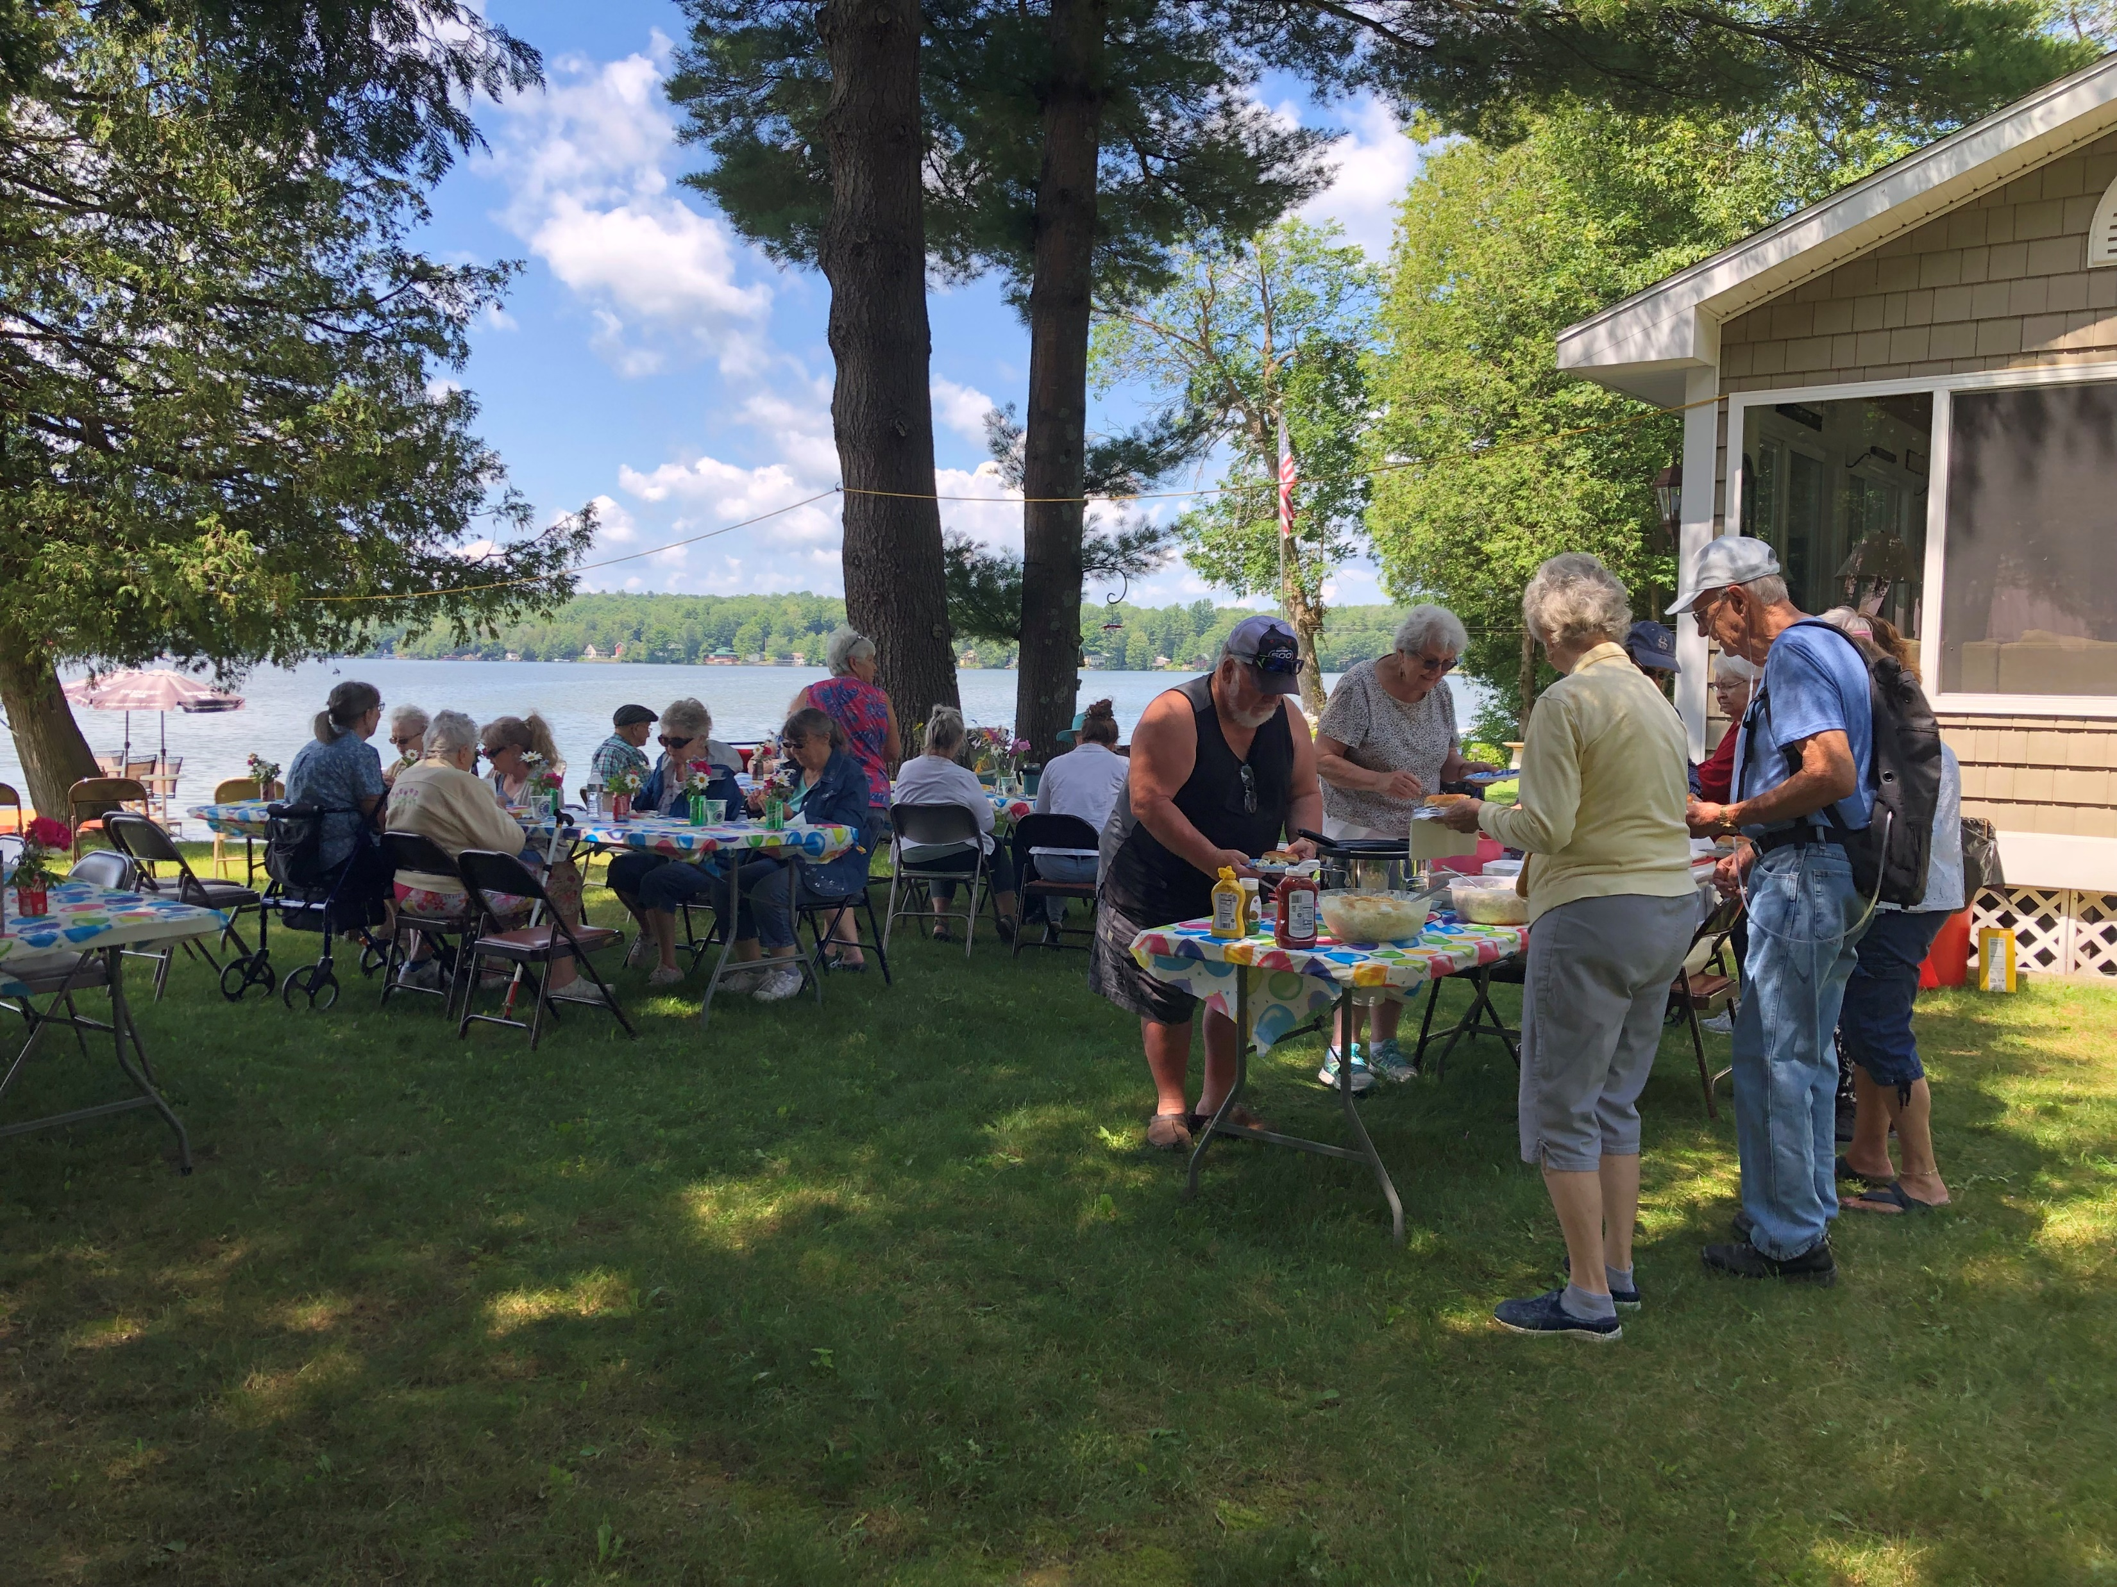
July 13, 2022
Carriage House/Homestead Lunch and Boat Tour
Sponsored by LCCA

Slide 19
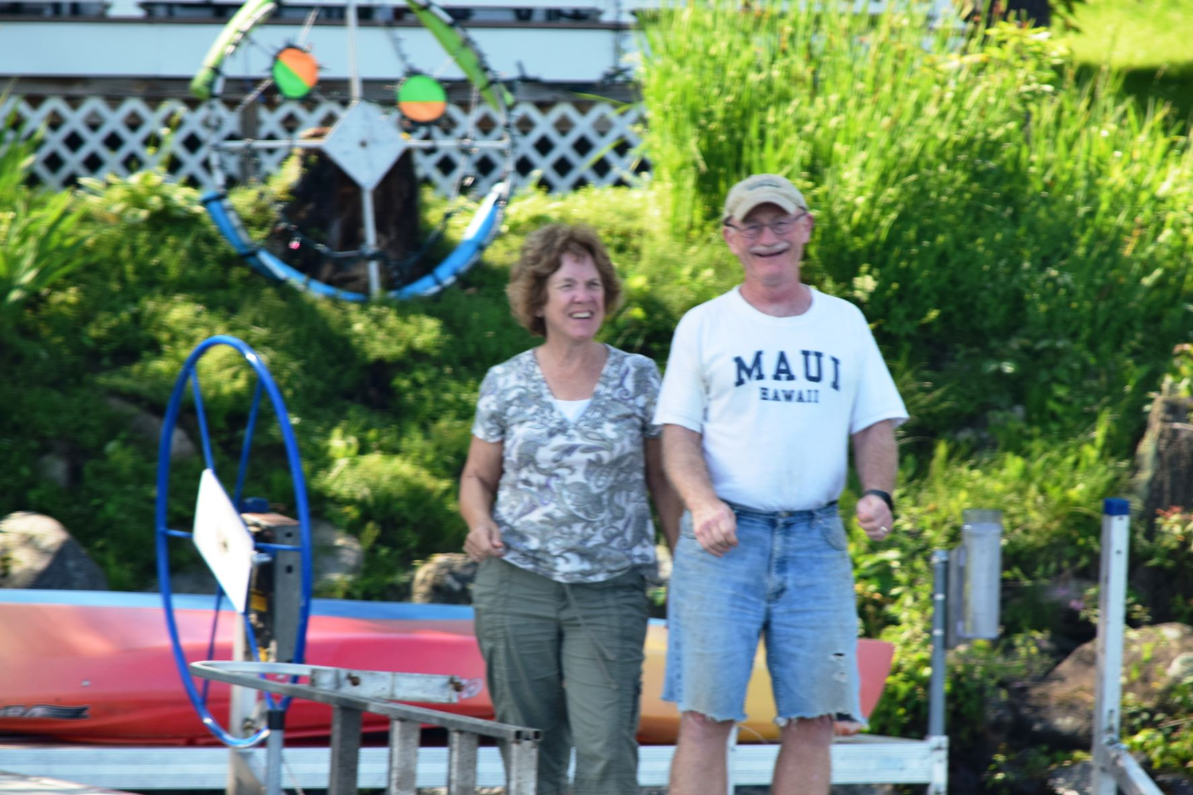
Pete and Marion Benevento
Two individuals who have worked so hard for so long to save Lake Carmi.

Slide 20
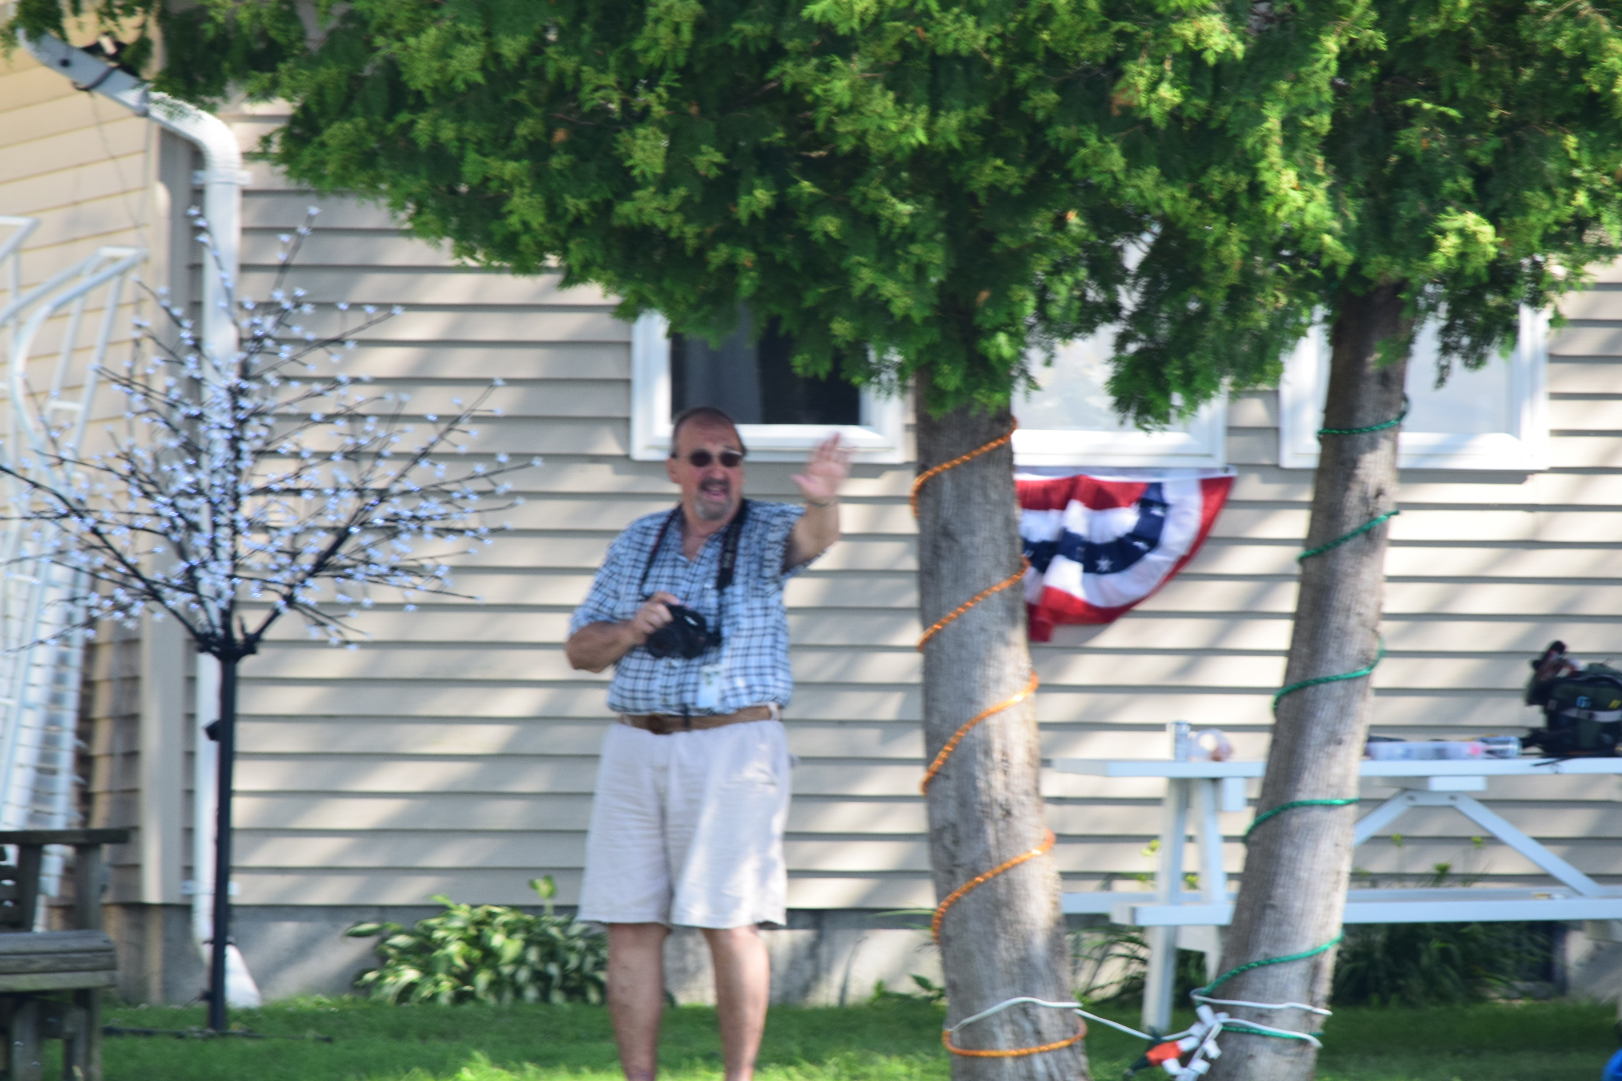
Larry Myott
Devoted his life to Lake Carmi and the Agricultural Industry.

Slide 21
Lake Carmi is not just a lake-
Lake Carmi is a family!!!

